Slide 1
Unit 1
Introduction To Computer Networks
Notes:
07/18/22

Slide 2
1-1 DATA COMMUNICATIONS
The term telecommunication means communication at a distance. The word data refers to information presented in whatever form is agreed upon by the parties creating and using the data.
Data communications are the exchange of data between two devices via some form of transmission medium such as a wire cable or wireless.
Delivery → Correct destination
Accuracy → Accurate data
Timelines → Real-time transmission
Jitter → Uneven delay
1.2
Notes:
07/18/22

Slide 3
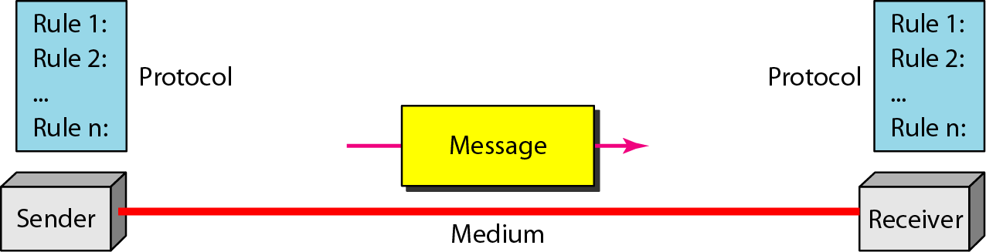
Topics discussed in this section:
Components
Data Representation Data Flow
Components
Figure 1.1 Five components of data communication
5
1
2
3
4
1.3
Notes:
07/18/22

Slide 4
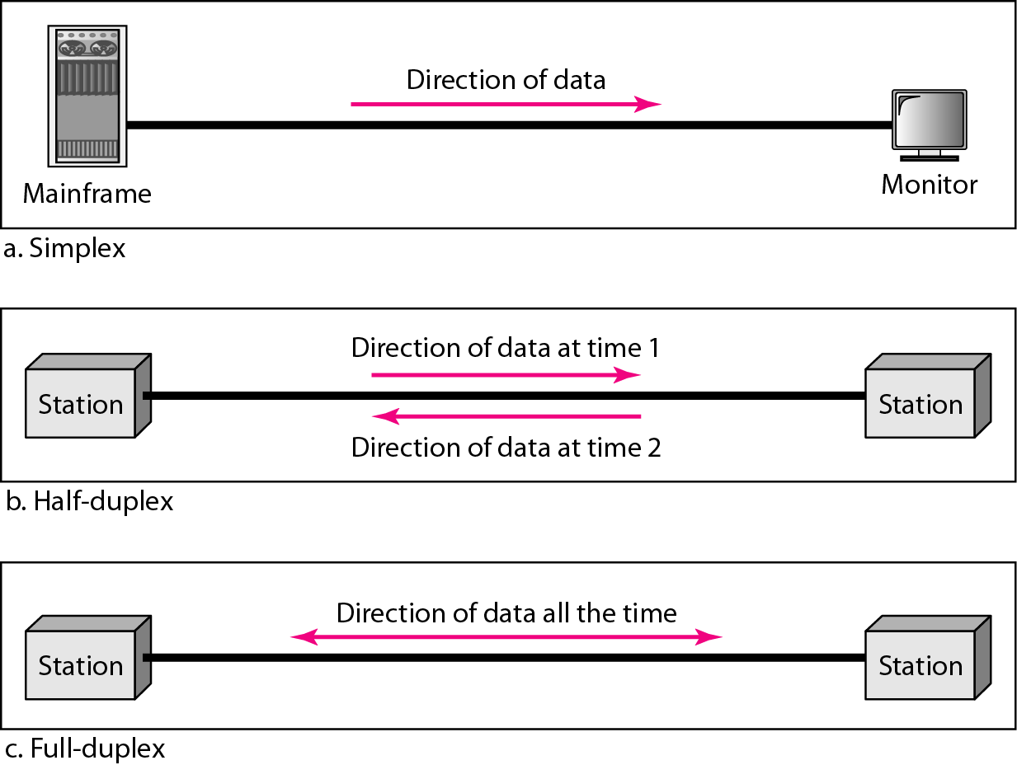
Data Representation
Text
Numbers
Images
Audio
Video
Data flow
Simplex
Half-duplex
Full-duplex
1.4
Notes:
07/18/22

Slide 5
1-2 NETWORKS
A network is a set of devices (nodes) connected by communication links. A node can be a computer, printer, or any other device capable of sending and/or receiving data generated by other nodes on the network.
Topics discussed in this section:
Distributed Processing
Network Criteria (performance, reliability, and security) Physical Structures ( type of connections and topologies) Network Models
Categories of Networks ( LAN, MAN and WAN) Interconnection of Networks: Internet
1.5
Notes:
07/18/22

Slide 6
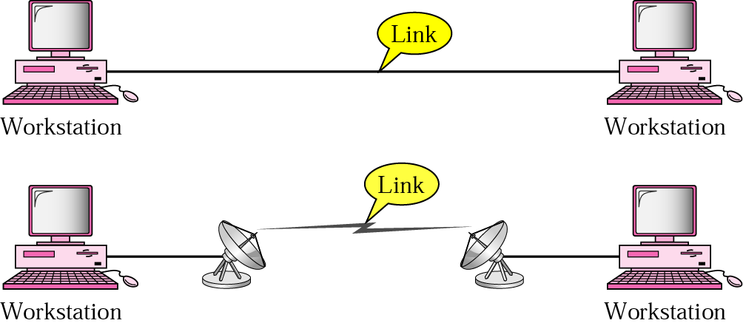
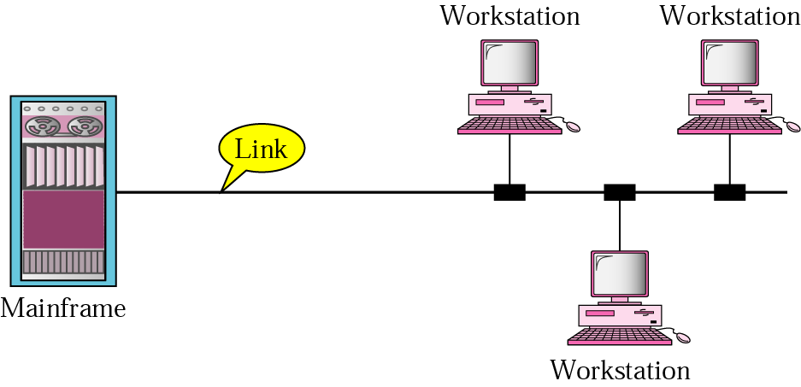
Types of connections
Point to point
A dedicated link is provided between two devices
Multipoint
More than two specific devices share a single link
1.6
Notes:
07/18/22

Slide 7
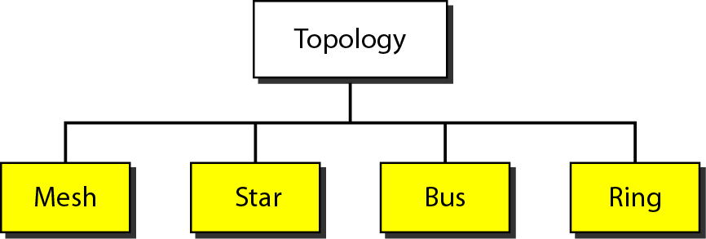
Physical Topology
Tree
1.7
Notes:
07/18/22

Slide 8
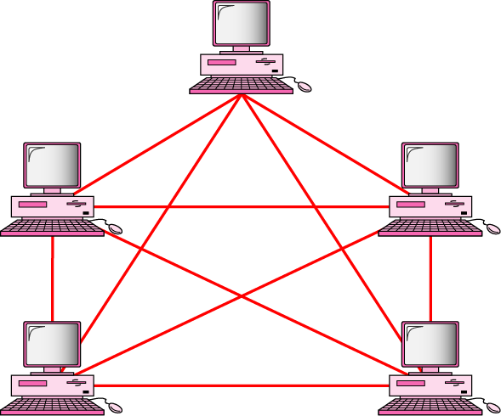
MESH Topology
Every device has a dedicated point-to-point link to every other devices
Dedicated
Link carries traffic only between the two devices it connects
A fully connected mesh network has n(n-1)/2 physical channels to link n devices
Every device on the network must have n-1 input/output (I/O) ports
Advantage
Less traffic, robust, secure, easy to maintain
Disadvantage
Need more resource (cable and ports), expensive
n(n-1)/2 physical duplex links
1.8

Slide 9
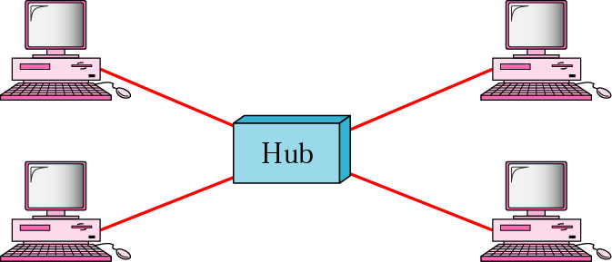
STAR Topology
Each device has a dedicated point-to-point link only to a central controller, usually called a hub.
No direct traffic and link between devices
Advantages
Less expensive
Easy to install and reconfigure
Robustness
Disadvantage
Single point of failure
1.9

Slide 10
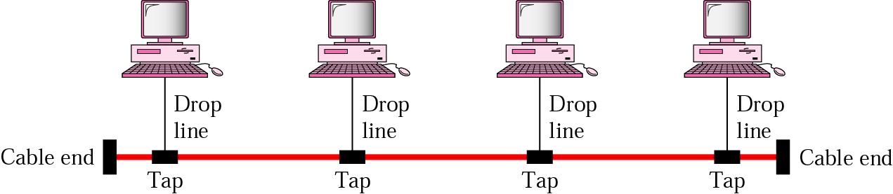
BUS Topology
A multipoint topology
All devices are linked through a backbone cable
Nodes are connected to the bus cable by drop lines and taps.
Drop line
A connection running between the device and the main cable
Tap
A connector that either splices into the main cable or punctures the sheathing of a cable to create a contact with the metallic core
Advantage:
Ease of installation
Disadvantages:
Difficult reconnection and fault isolation
Broken or fault of the bus cable stops all transmission
1.10

Slide 11
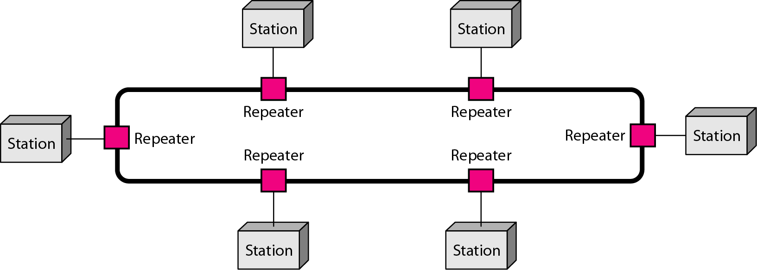
RING Topology
Each device is dedicated point-to-point connection only with the two devices on either side of it
A signal is passed along the ring in the direction, from device to device, until it reaches its destination
Each device in the ring incorporates a repeater
Advantages
Relatively easy to install and reconfigure
Fault isolation is simplified
Disadvantage
Unidirectional traffic
1.11

Slide 12
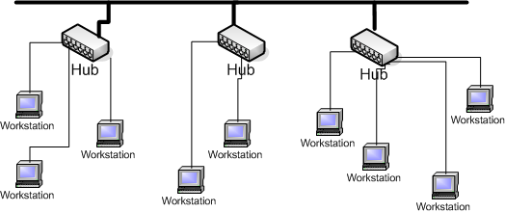
Tree Topology
Tree topologies integrate multiple topologies together
Example: Tree topology integrates multiple star topologies together onto a bus
Advantages:
Point-to-point wiring for individual segments.
Supported by several hardware and software venders.
Disadvantages:
Overall length of each segment is limited by the type of cabling used.
If the backbone line breaks, the entire segment goes down.
More difficult to configure and wire than other topologies.
1.12

Slide 13
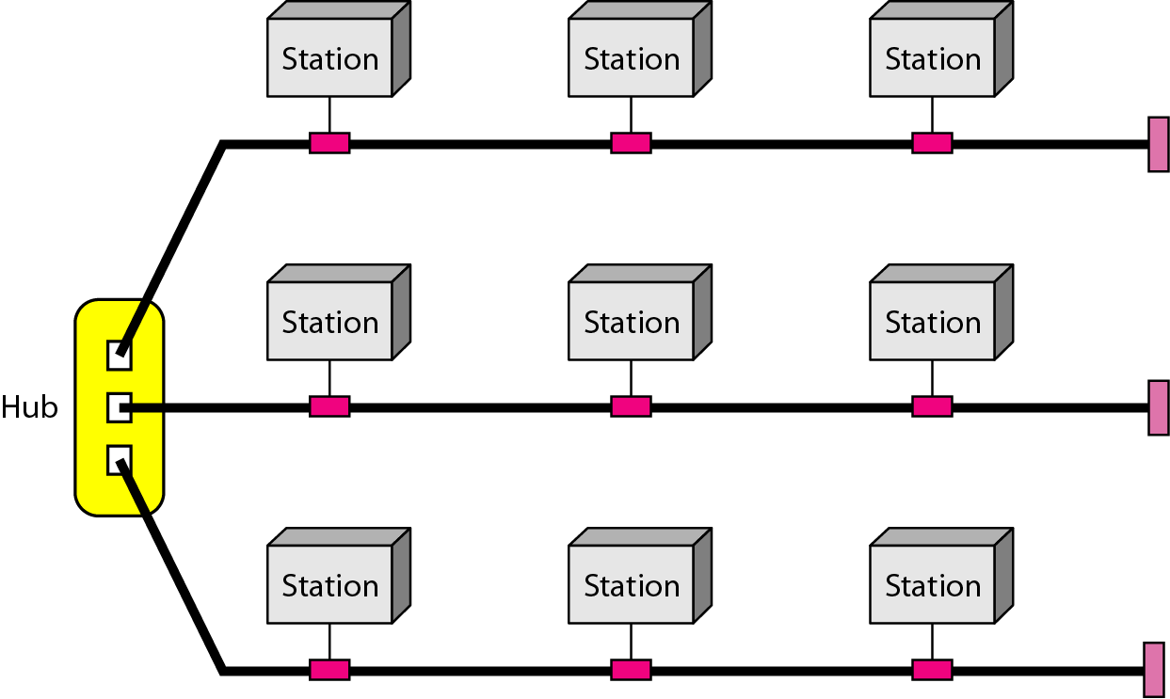
A hybrid topology: a star backbone with three bus networks
1.13
Notes:
07/18/22

Slide 14
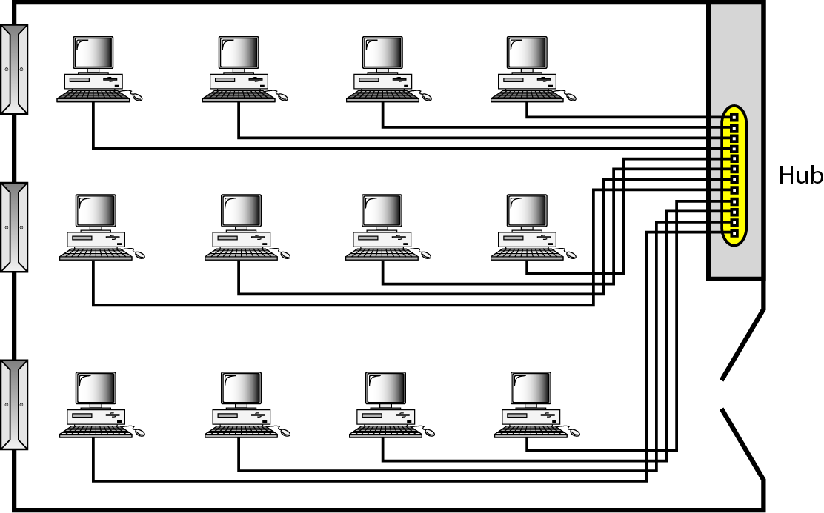
Categories of Networks
Local Area Network (LAN)
Wireless Local Area Network (WLAN)
Metropolitan Area Network (MAN)
Wide Area Network (WAN)
An isolated LAN connecting 12 computers to a hub in a closet
1.14
Notes:
07/18/22

Slide 15
Local Area Networks (LANs):
• A local area network (LAN) is a computer network covering a small geographic area, like a home, office,
or group of buildings
Metropolitan Area Network (MAN):
• A metropolitan area network (MAN) is a network that interconnects users with computer resources in a geographic area or region larger than that covered by even a large local area network (LAN) but smaller than the area covered by a wide area network (WAN).
• The term is applied to the interconnection of networks in a city into a single larger network (which may then also offer efficient connection to a wide area network). It is also used to mean the interconnection of several local area networks by bridging them with backbone lines. The latter usage is also sometimes referred to as a campus network.

Slide 16
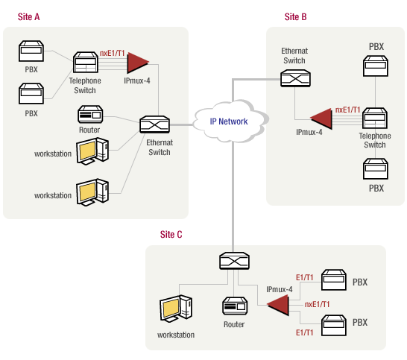
Categories of Networks
Metropolitan Area Network (MAN)
1.16
Notes:
07/18/22

Slide 17
Wide Area Networks (WANs):
• Wide Area Network (WAN) is a computer network that covers a broad area (i.e., any network whose communications links cross metropolitan, regional, or national boundaries). Or, less formally, a network that uses routers and public communications links
• The largest and most well-known example of a WAN is the Internet.
• WANs are used to connect LANs and other types of networks together, so that users and computers in
one location can communicate with users and computers in other locations

Slide 18
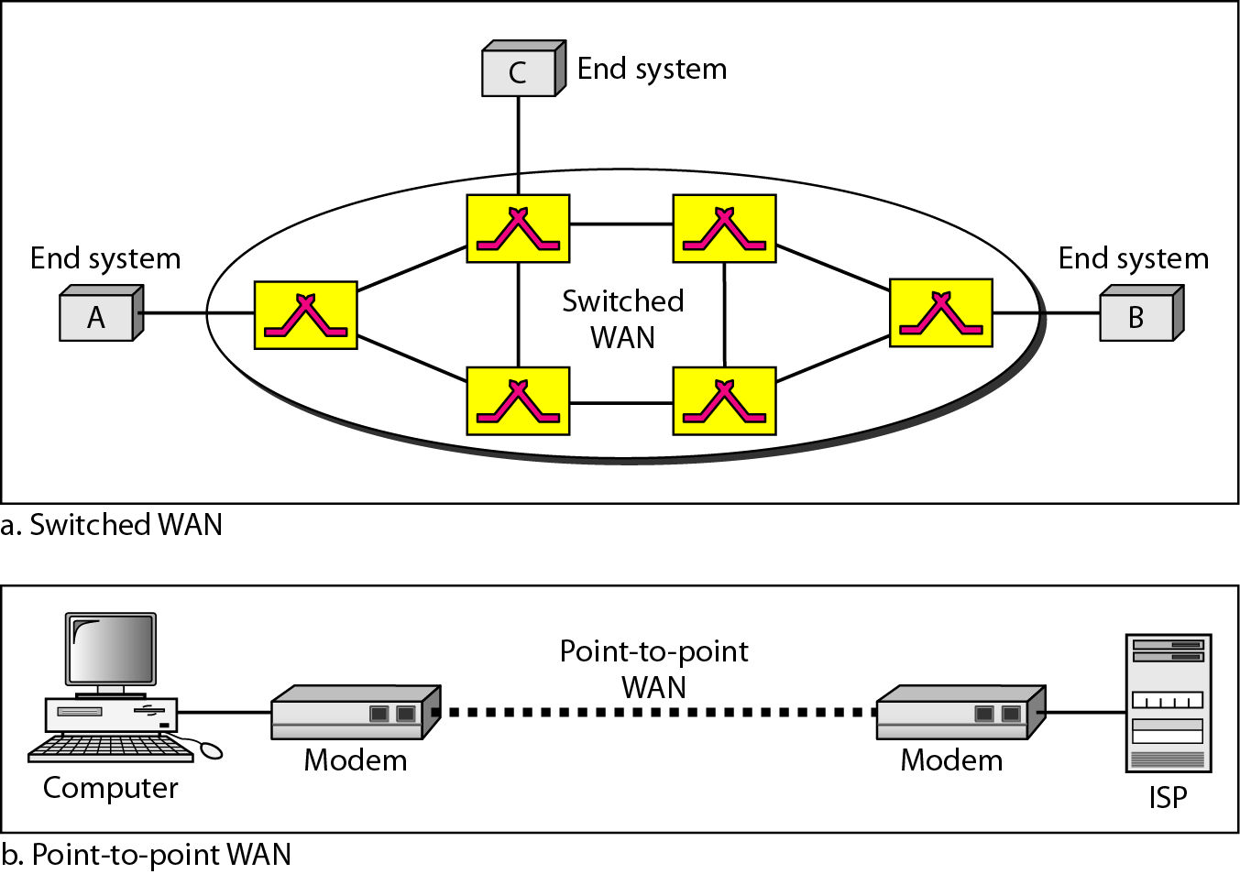
WANs: a switched WAN and a point-to-point WAN
1.18
Notes:
07/18/22

Slide 19
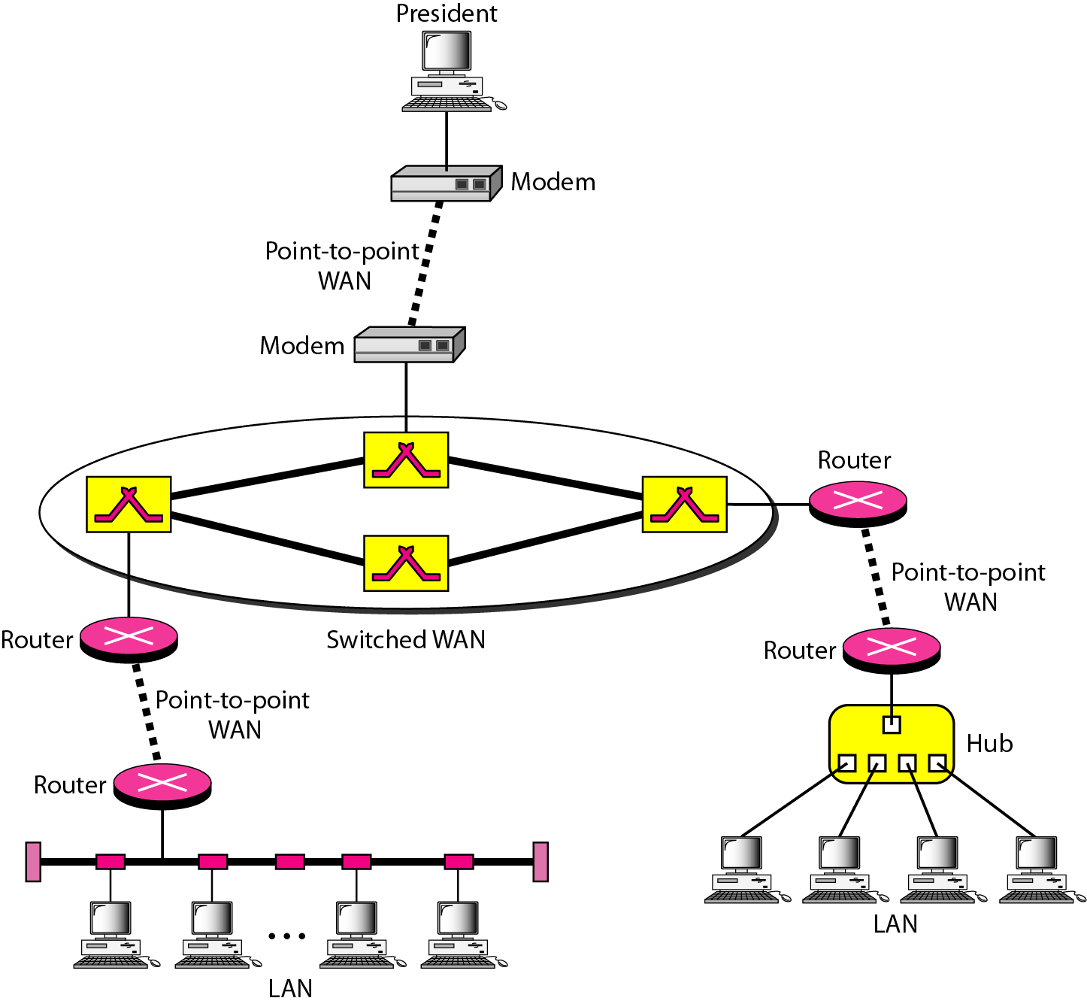
Interconnection of Networks: internet
A heterogeneous network made of four WANs and two LANs
1.19
Notes:
07/18/22

Slide 20
Wireless networks:
A wireless network is a computer network that uses wireless data connections between network nodes.
Wireless networking is a method by which homes, telecommunications networks and business installations avoid the costly process of introducing cables into a building, or as a connection between various equipment locations.
Admin telecommunications networks are generally implemented and administered using radio communication. This implementation takes place at the physical level (layer) of the OSI model network structure.
Examples of wireless networks include cell phone networks, wireless local area networks (WLANs), wireless sensor networks, satellite communication networks, and terrestrial microwave networks.

Slide 21
Types of wireless networks
Wireless LAN-A wireless local area network (WLAN) links two or more devices over a short distance using a wireless distribution method, usually providing a connection through an access point for internet access.
Wireless MAN-Wireless metropolitan area networks are a type of wireless network that connects several wireless LANs.
Wireless PAN-Wireless personal area networks (WPANs) connect devices within a relatively small area, that is generally within a person's reach.
Wireless ad hoc network-A wireless ad hoc network, also known as a wireless mesh network or mobile ad hoc network (MANET), is a wireless network made up of radio nodes organized in a mesh topology.

Slide 22
Contin....
Wireless WAN-Wireless wide area networks are wireless networks that typically cover large areas, such as between neighbouring towns and cities, or city and suburb.
Cellular network-A cellular network or mobile network is a radio network distributed over land areas called cells, each served by at least one fixed-location transceiver, known as a cell site or base station.
Global area network-A global area network (GAN) is a network used for supporting mobile across an arbitrary number of wireless LANs, satellite coverage areas, etc.
Space network-Space networks are networks used for communication between spacecraft, usually in the vicinity of the Earth. The example of this is NASA's Space Network.

Slide 23
Network software
Network software is defined as a wide range of software that streamlines the operations, design, monitoring, and implementation of computer networks.
Functions of network software:
User management- allows administrators to add or remove users from the network. This is particularly useful when hiring or relieving
File management- lets administrators decide the location of data storage and control user access to that data.
Access- enables users to enjoy uninterrupted access to network resources.
Network security systems- assist administrators in looking after security and preventing data breaches.

Slide 24
1-3 THE INTERNET
The Internet has changed many aspects of our daily lives. It has affected the way we do business as well as the way we spend our leisure time. The Internet is a communication system that has brought a wealth of information to our fingertips and organized it for our use.
Topics discussed in this section:
A Brief History → ARPANET
1967 ACM
1969 UCLA, UCSB, SRI, UoU
1972 TCP
The Internet Today (ISPs)
1.24
Notes:
07/18/22

Slide 25
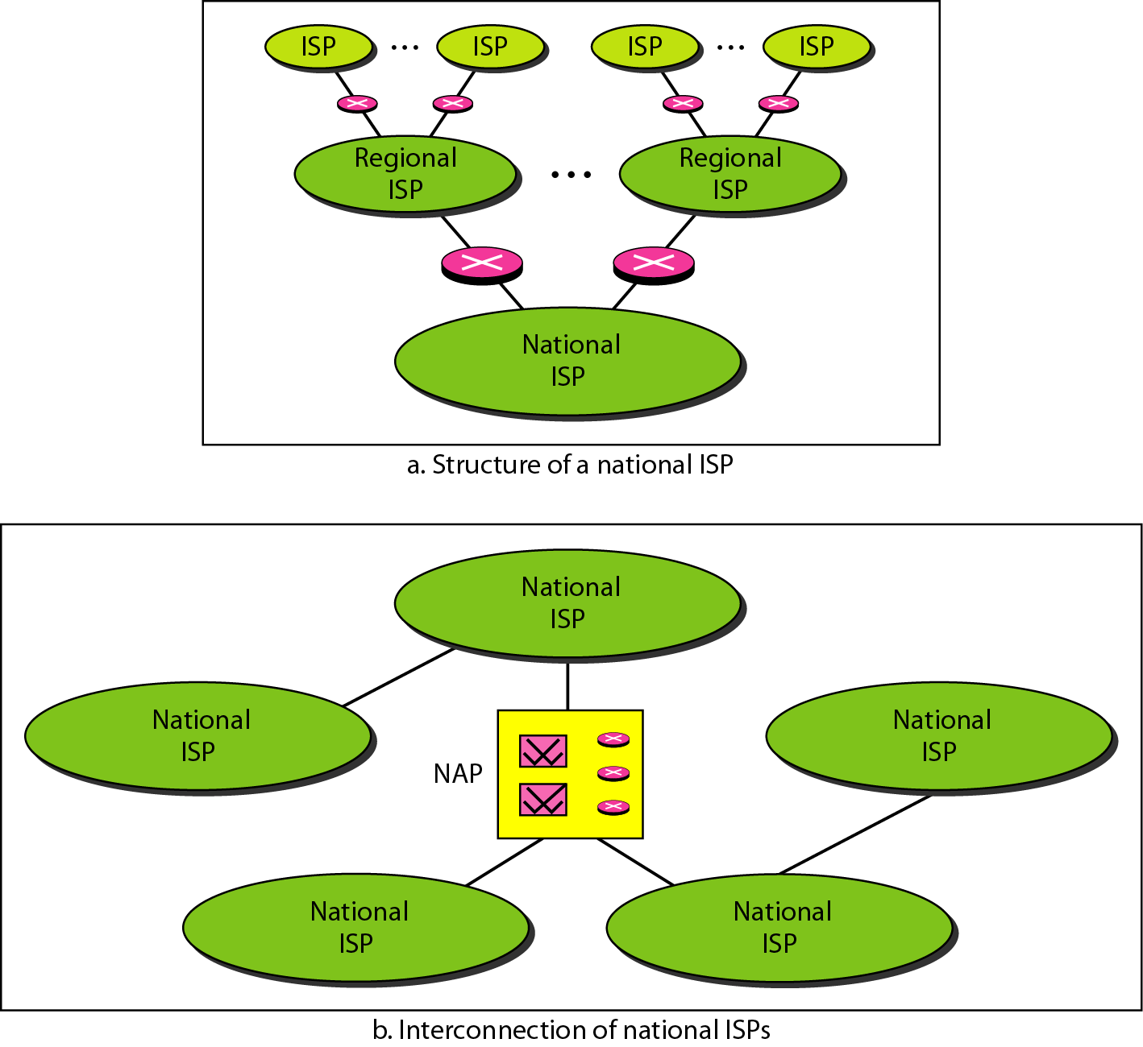
Hierarchical organization of the Internet
1.25
Notes:
07/18/22

Slide 26
1-4 PROTOCOLS AND STANDARDS
protocols and standards.
Protocol is synonymous with rule.
Standards are agreed-upon rules.
Topics discussed in this section:
Protocols Standards
Standards Organizations
Internet Standards
1.26
Notes:
07/18/22

Slide 27
PROTOCOLS AND STANDARDS
Protocols
Syntax → format of the data
Semantics → meaning of each section
Timing → when data should be sent and how fast.
Standards
De facto → by fact (not approved as a standard)
De jure → by Law (approved)
1.27
Notes:
07/18/22

Slide 28
PROTOCOLS AND STANDARDS
Standards Organizations
International Organization for Standardization (ISO)
International Telecommunication Union - Telecommunication Standards (ITU-T)
American National Standards Institute (ANSI)
Institute of Electrical and Electronics Engineers (IEEE)
Electronic Industries Association (EIA)
1.28
Notes:
07/18/22

Slide 29
Design issues for the Network layers
A number of design issues exist for the layer to layer approach of computer networks. Some are as follows:
1. Reliability: Network channels and components may be unreliable, resulting in loss of bits while data transfer.
2. Scalability: Networks are continuously evolving. The sizes are continually increasing leading to congestion. Also, when new technologies are applied to the added components, it may lead to incompatibility issues.
3. Addressing: At a particular time, innumerable messages are being transferred between large numbers of computers. So, a naming or addressing system should exist so that each layer can identify the sender and receivers of each message.

Slide 30
Contin....
4. Error Control: Unreliable channels introduce a number of errors in the data streams that are communicated. So, the layers need to agree upon common error detection and error correction methods
5. Flow Control: If the rate at which data is produced by the sender is higher than the rate at which data is received by the receiver, there are chances of overflowing the receiver.
6. Resource Allocation: Computer networks provide services in the form of network resources to the end users. The main design issue is to allocate and deallocate resources to processes.

Slide 31
Contin....
7. Routing: There may be multiple paths from the source to the destination. Routing involves choosing an optimal path among all possible paths, in terms of cost and time.
8. Security: A major factor of data communication is to defend it against threats like eavesdropping and surreptitious alteration of messages. .

Slide 32
Network Models
1.OSI Model
1.32

Slide 33
1-5 LAYERED TASKS
A network model is a layered architecture
Task broken into subtasks
Implemented separately in layers in stack
Functions need in both systems
Peer layers communicate
Protocol:
A set of rules that governs data communication
It represents an agreement between the communicating devices
1.33

Slide 34
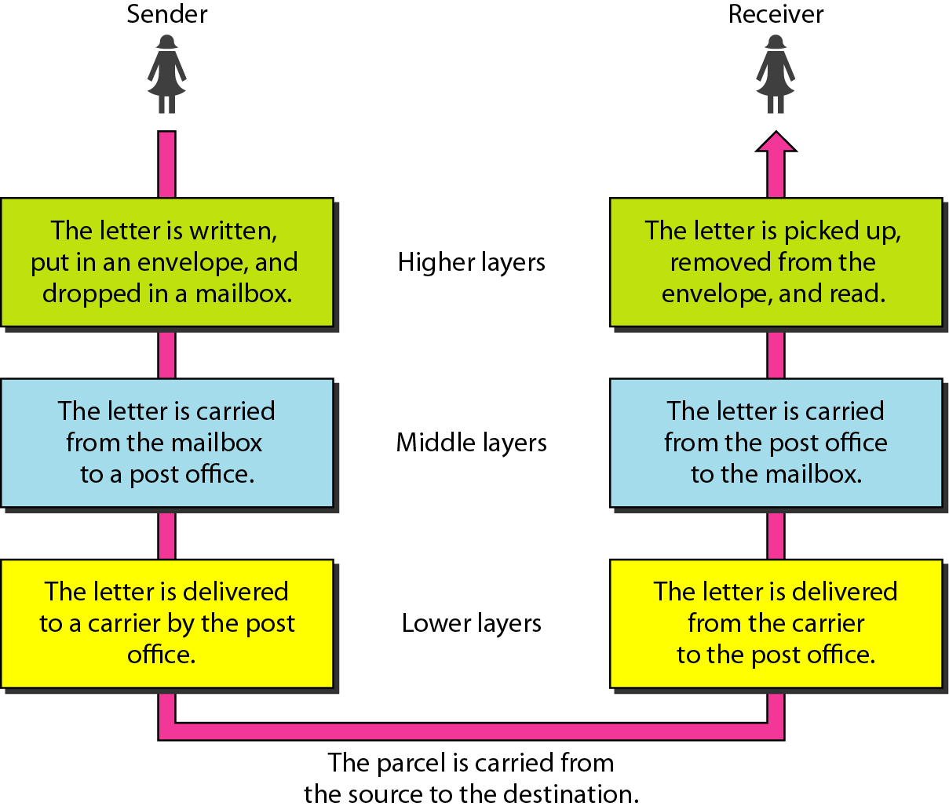
Tasks involved in sending a letter
Topics discussed in this section:
Sender, Receiver, and Carrier Hierarchy (services)
1.34

Slide 35
1-5.1 THE OSI MODEL
Established in 1947, the International Standards Organization (ISO) is a multinational body dedicated to worldwide agreement on international standards.
1.35

Slide 36
ISO is the organization. OSI is the model.
Topics discussed in this section:
Layered Architecture Peer-to-Peer Processes
Encapsulation
1.36

Slide 37
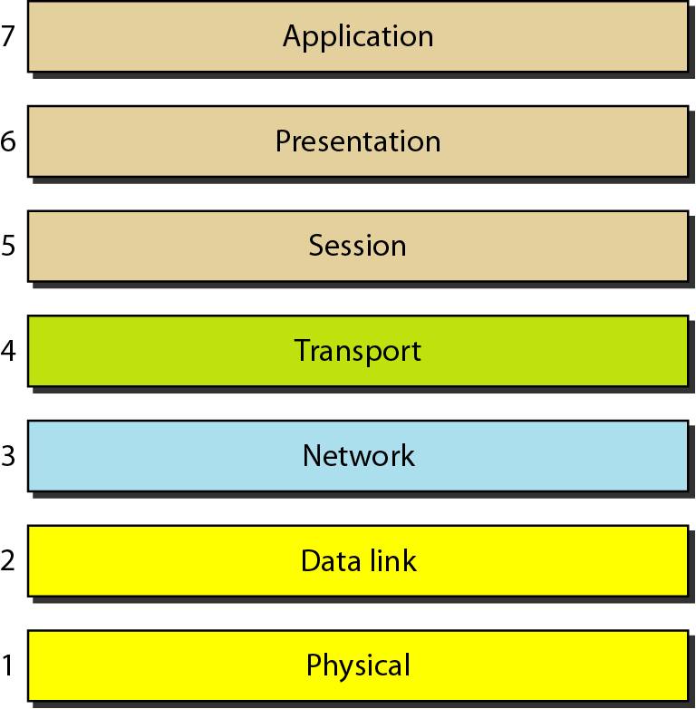
Layered Architecture
Layers
Layer 7. Application
Layer 6. Presentation
Layer 5. Session
Layer 4. Transport
Layer 3. Network
Layer 2. Data Link
Layer 1. Physical
Seven layers of the OSI model
Sender
Receiver
1.37

Slide 38
Layered Architecture
A layered model
Each layer performs a subset of the required communication functions
Each layer relies on the next lower layer to perform more primitive functions
Each layer provides services to the next higher layer
Changes in one layer should not require changes in other layers
The processes on each machine at a given layer are called peer-to-peer process
1.38

Slide 39
PEER – TO – PEER PROCESS
Communication must move downward through the layers on the sending device, over the communication channel, and upward to the receiving device
Each layer in the sending device adds its own information to the message it receives from the layer just above it and passes the whole package to the layer just below it
At the receiving device, the message is unwrapped layer by layer, with each process receiving and removing the data meant for it
1.39

Slide 40
PEER – TO – PEER PROCESS
The passing of the data and network information down through the layers of the sending device and backup through the layers of the receiving device is made possible by interface between each pair of adjacent layers
Interface defines what information and services a layer must provide for the layer above it.
1.40

Slide 41
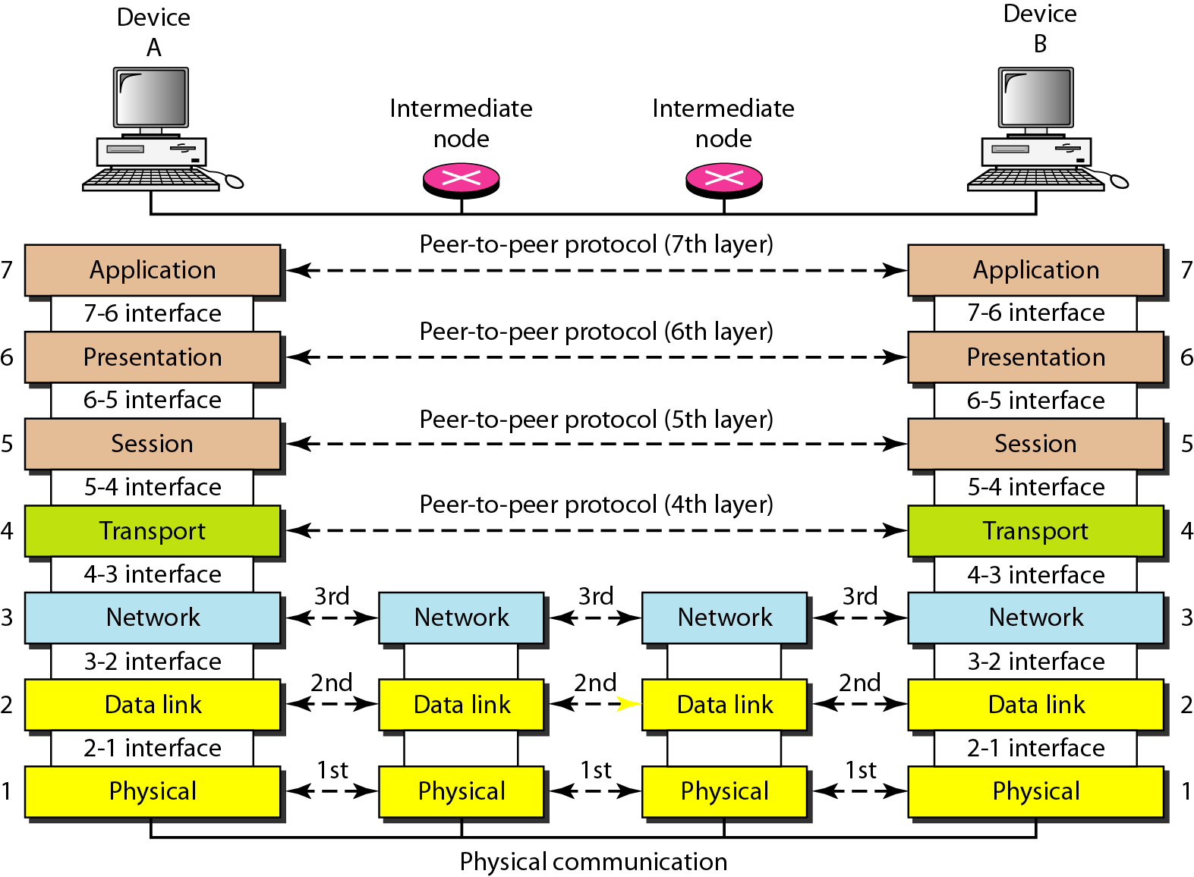
The interaction between layers in the OSI model
1.41

Slide 42
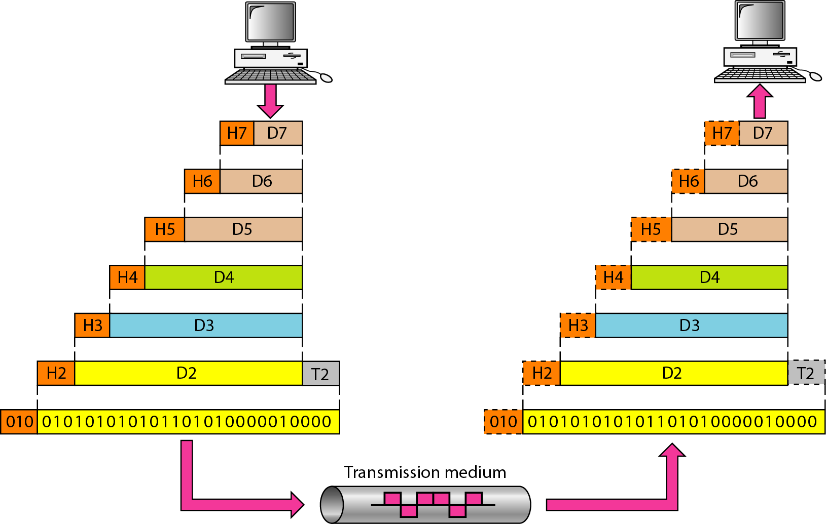
An exchange using the OSI model
1.42

Slide 43
LAYERS IN THE OSI MODEL
Topics discussed in this section:
Physical Layer
Data Link Layer
Network Layer
Transport Layer
Session Layer
Presentation Layer
Application Layer
1.43

Slide 44
Physical Layer
The physical layer is responsible for movements of
individual bits from one hop (node) to the next.
Function
Physical characteristics of interfaces and media
Representation of bits
Data rate
Synchronization of bits
Line configuration (point-to-point or multipoint)
Physical topology (mesh, star, ring or bus)
Transmission mode ( simplex, half-duplex or duplex)
1.44

Slide 45
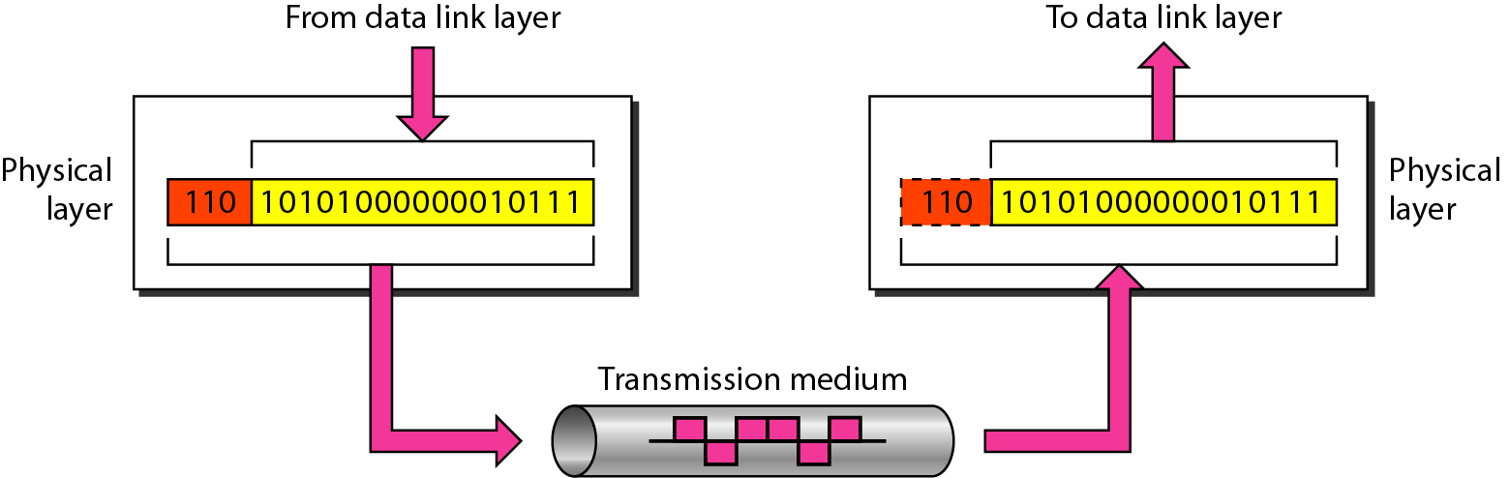
Physical layer
1.45

Slide 46
Data Link Layer
The data link layer is responsible for moving frames from one hop (node) to the next.
Function
Framing
Physical addressing(Media Access Control (MAC)address)
Flow control
Error control
Access control
1.46

Slide 47
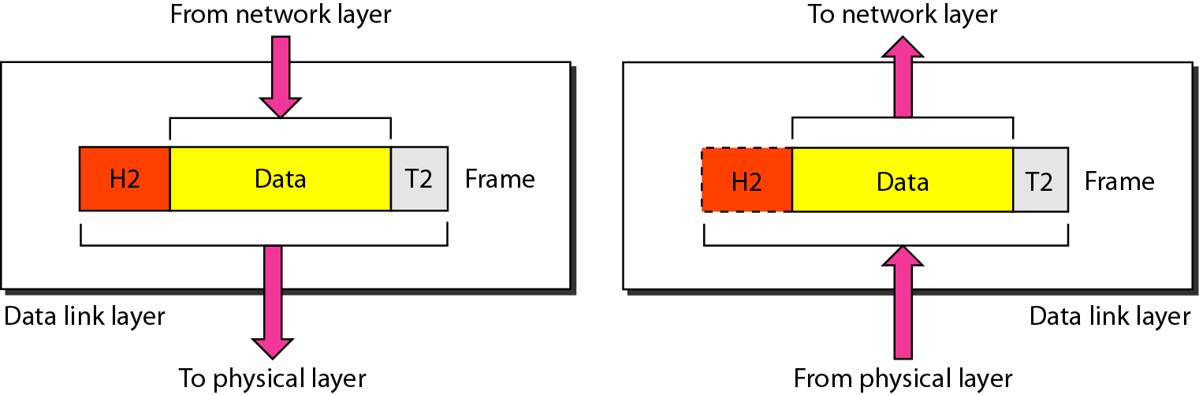
Data link layer
1.47

Slide 48
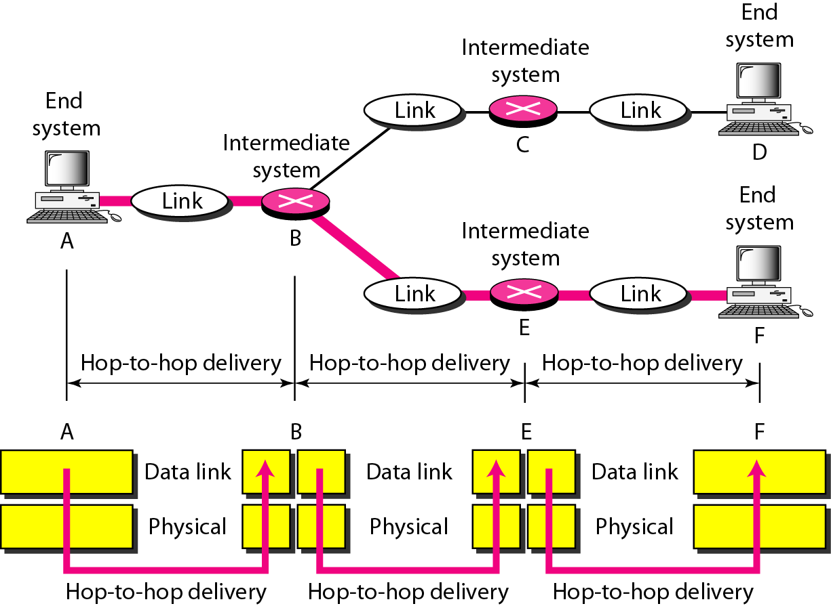
Hop-to-hop delivery
1.48

Slide 49
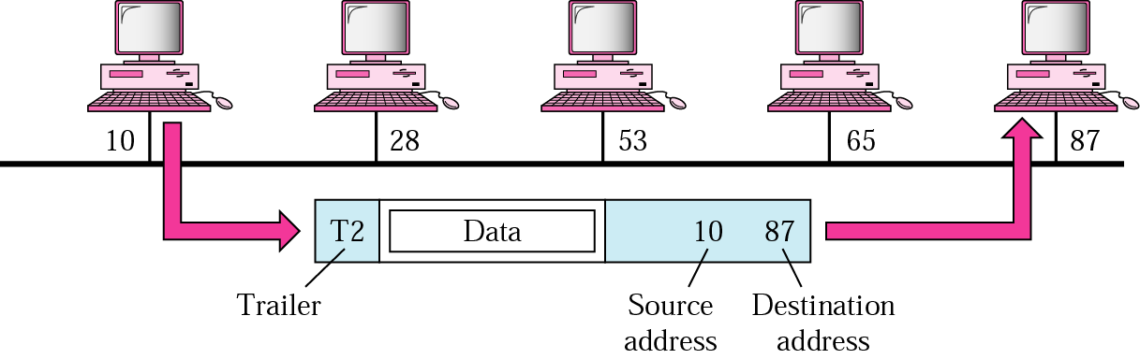
Example 1
In following Figure a node with physical address 10 sends a frame to a node with physical address 87. The two nodes are connected by a link. At the data link level this frame contains physical addresses in the header. These are the only addresses needed. The rest of the header contains other information needed at this level. The trailer usually contains extra bits needed for error detection
1.49

Slide 50
Network Layer
The network layer is responsible for the delivery of individual packets from
the source host to the destination host.
Source-to-destination delivery
Responsible from the delivery of packets from the original source to the final destination
Logical addressing(Internet Protocol addresses)
Routing
1.50

Slide 51
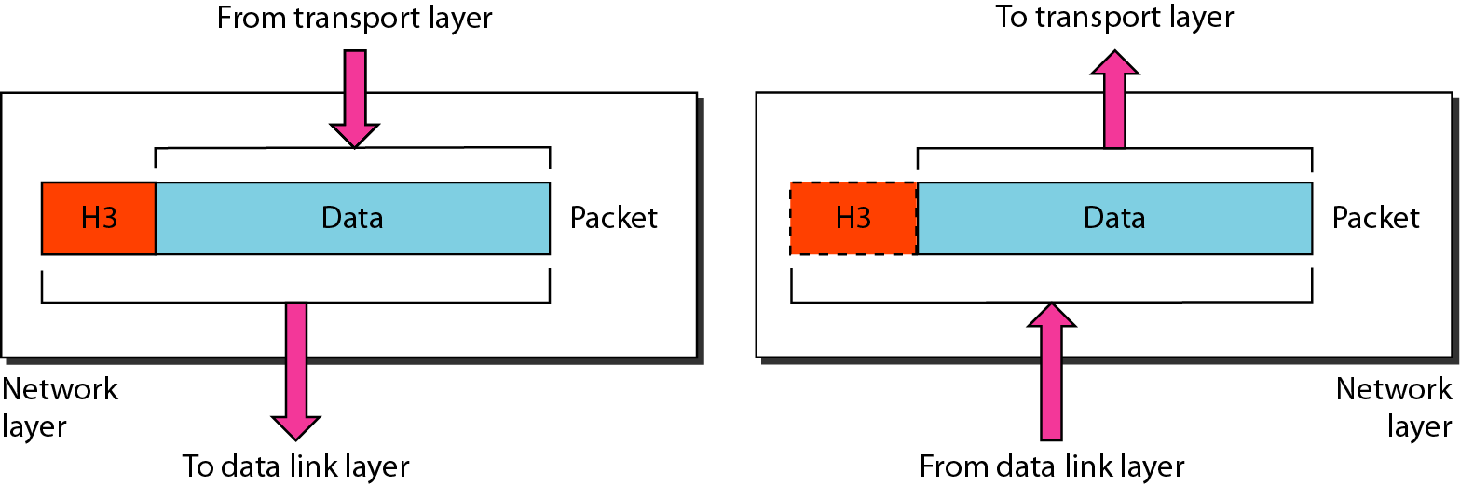
Network layer
1.51

Slide 52
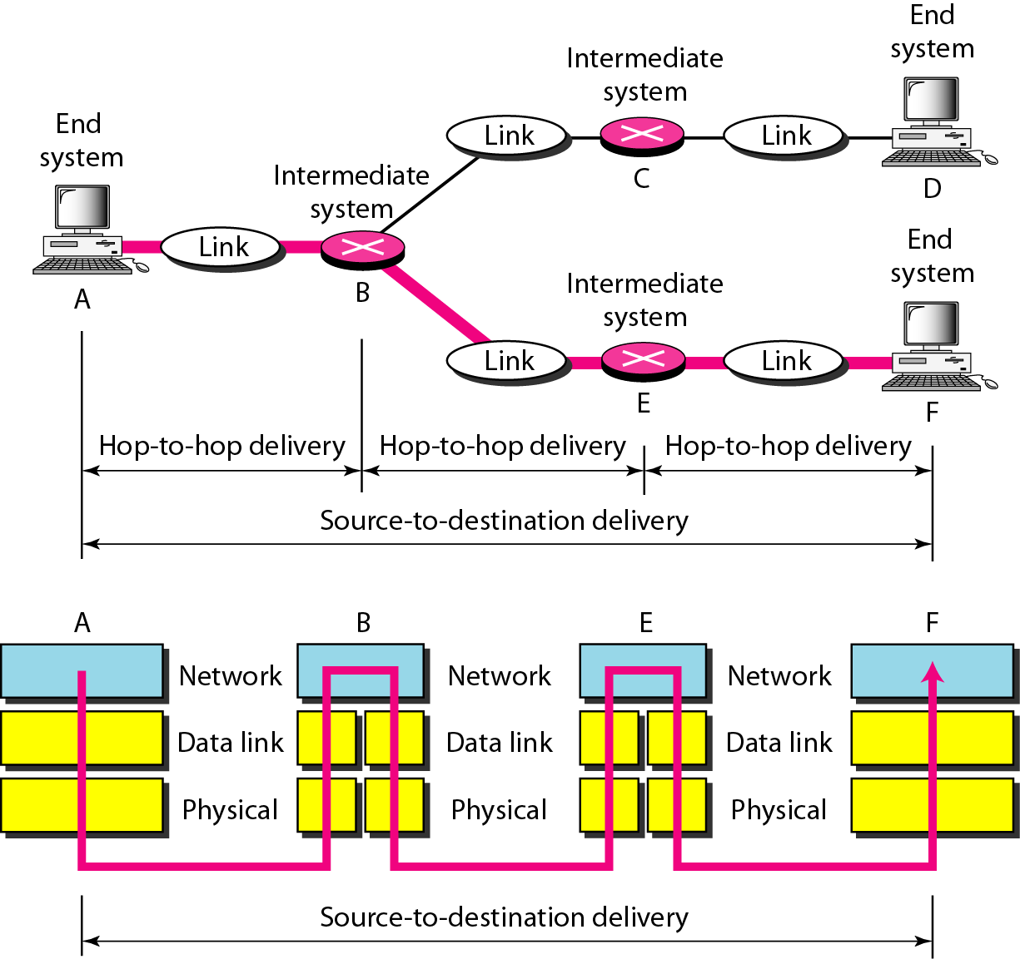
Source-to-destination delivery
1.52

Slide 53
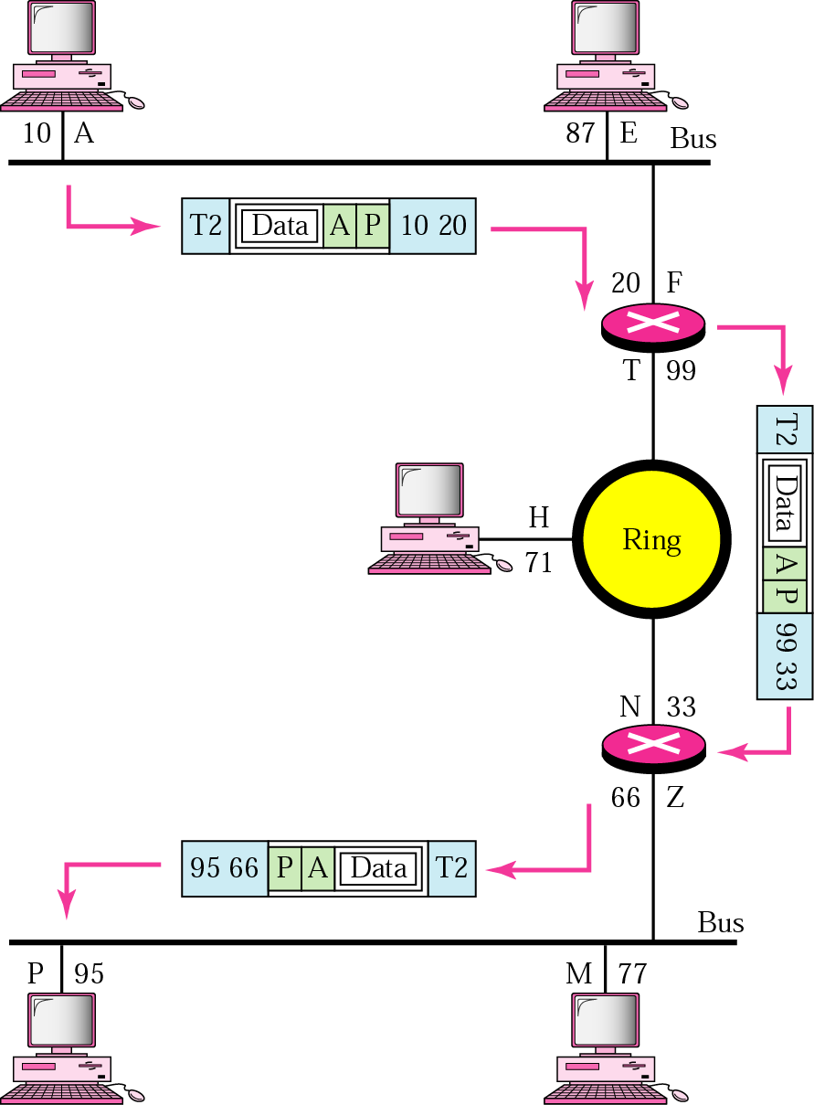
Example 2
We want to send data from a node with network address A and physical address 10, located on one LAN, to a node with a network address P and physical address 95, located on another LAN. Because the two devices are located on different networks, we cannot use physical addresses only; the physical addresses only have local influence. What we need here are universal addresses that can pass through the LAN boundaries. The network (logical) addresses have this characteristic.
1.53

Slide 54
Transport Layer
The transport layer is responsible for the delivery of a message from one process to another.
Process-to- process delivery
Functions
Port addressing
Segmentation and reassembly
Connection control ( Connection-oriented or connection-less)
Flow control
Error control
1.54

Slide 55
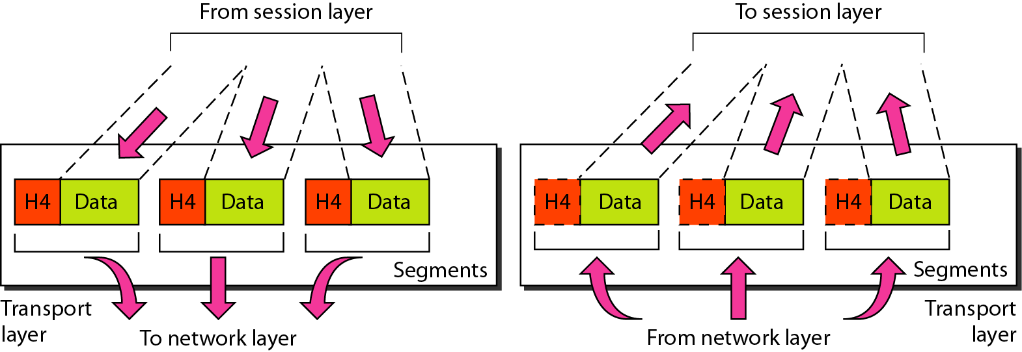
Transport layer
Segmentation and reassembly
1.55

Slide 56
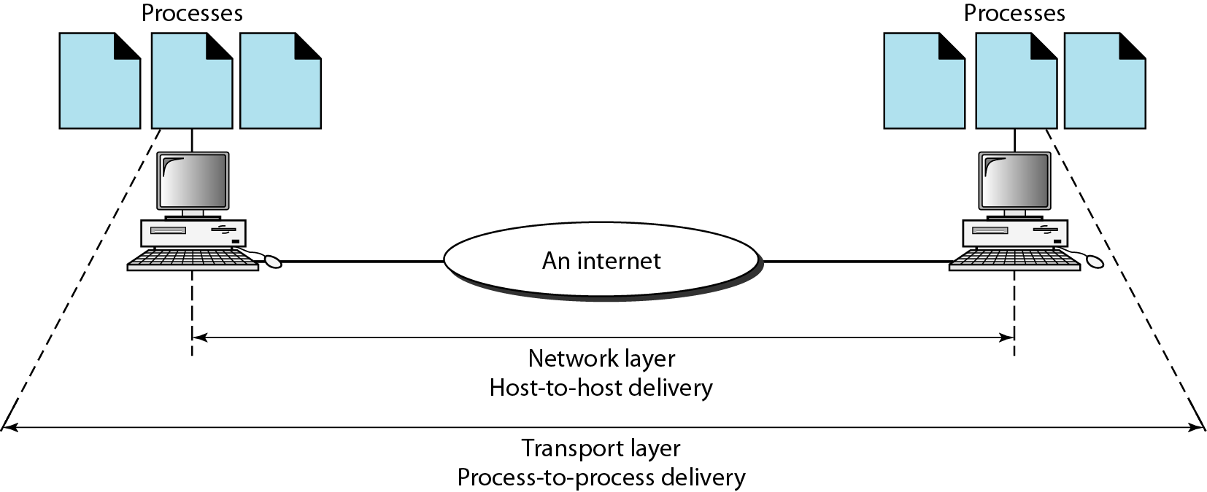
Reliable process-to-process delivery of a message
1.56

Slide 57
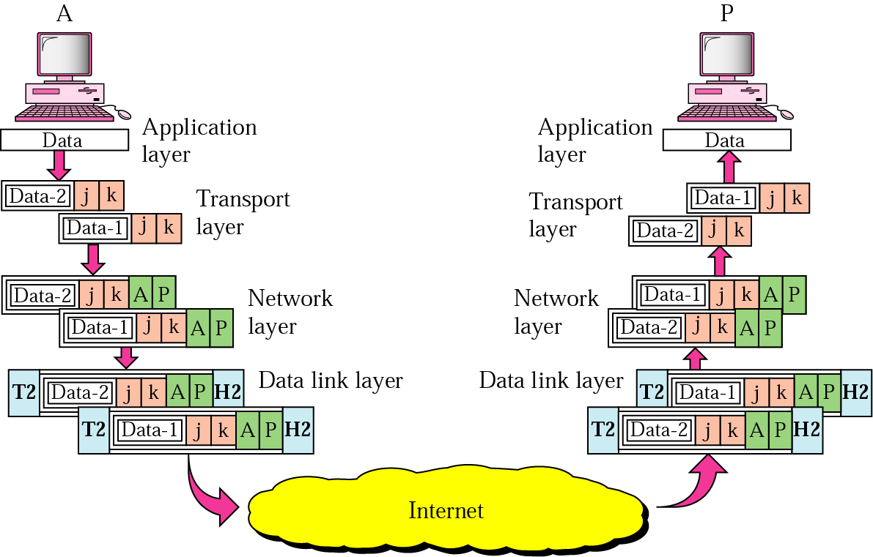
Example 3
Data coming from the upper layers have port addresses j and k (j is the address of the sending process, and k is the address of the receiving process). Since the data size is larger than the network layer can handle, the data are split into two packets, each packet retaining the port addresses (j and k). Then in the network layer, network addresses (A and P) are added to each packet.
1.57

Slide 58
Session Layer
The session layer is responsible for dialog control and synchronization.
This layer maintains sessions.
It establishes, maintains and synchronize the interaction between communicating system
Function
Dialog control
Synchronization (checkpoints)
1.58

Slide 59
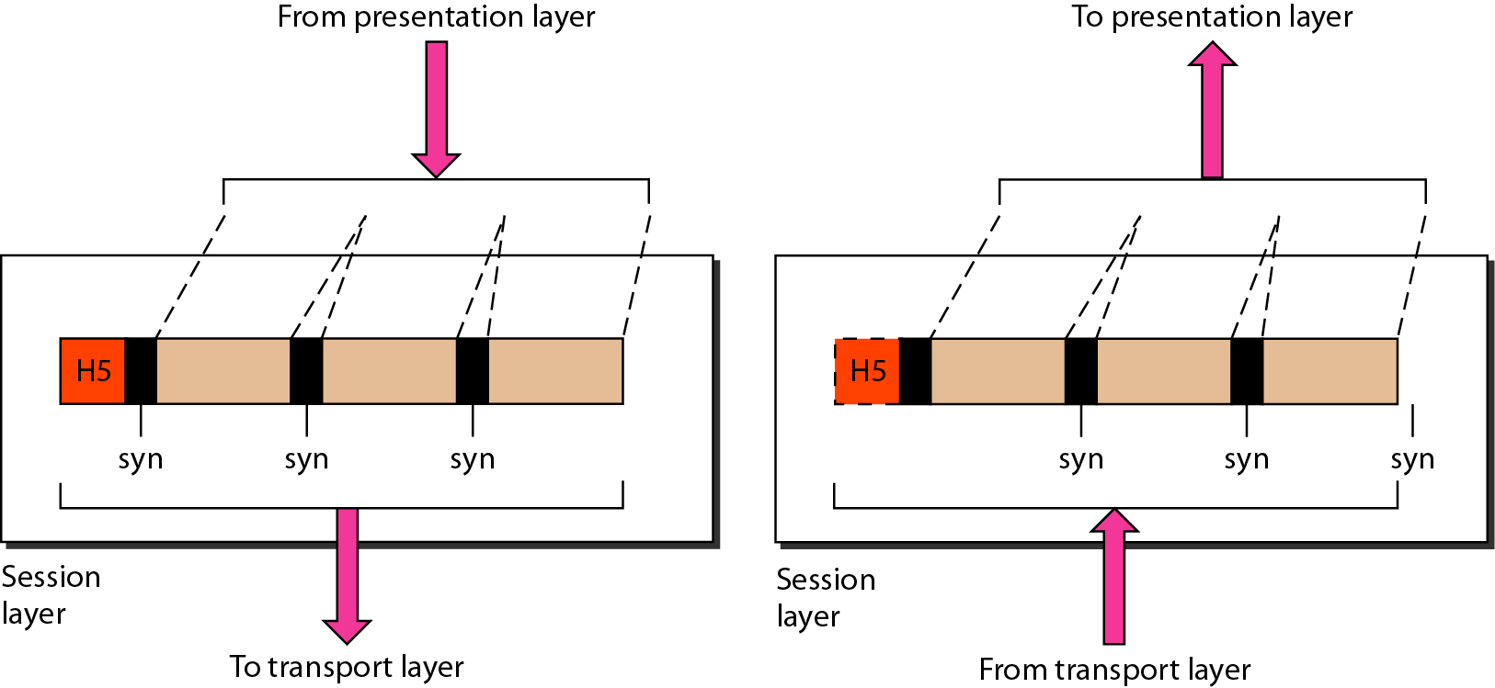
Session layer
Synchronization
1.59

Slide 60
Presentation Layer
The presentation layer is responsible for translation, compression, and encryption.
Concerned with the syntax and semantics of the information exchanged between two system
Functions
Translation ( EBCDIC-coded text file 🡪 ASCII-coded file)
Encryption and Decryption
Compression
1.60

Slide 61
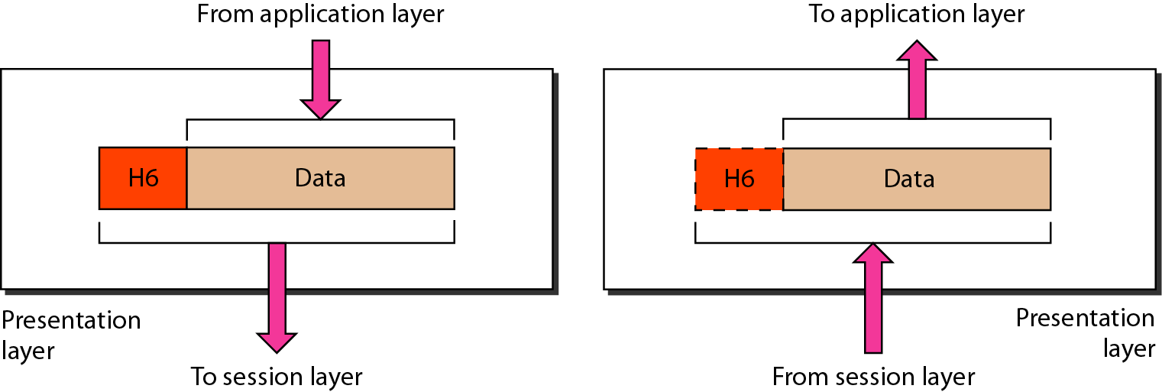
Presentation layer
1.61

Slide 62
Application Layer
The application layer is responsible for providing services to the user.
Functions
Network virtual terminal (Remote log-in)
File transfer and access
Mail services
Directory services (Distributed Database)
Accessing the World Wide Web
1.62

Slide 63
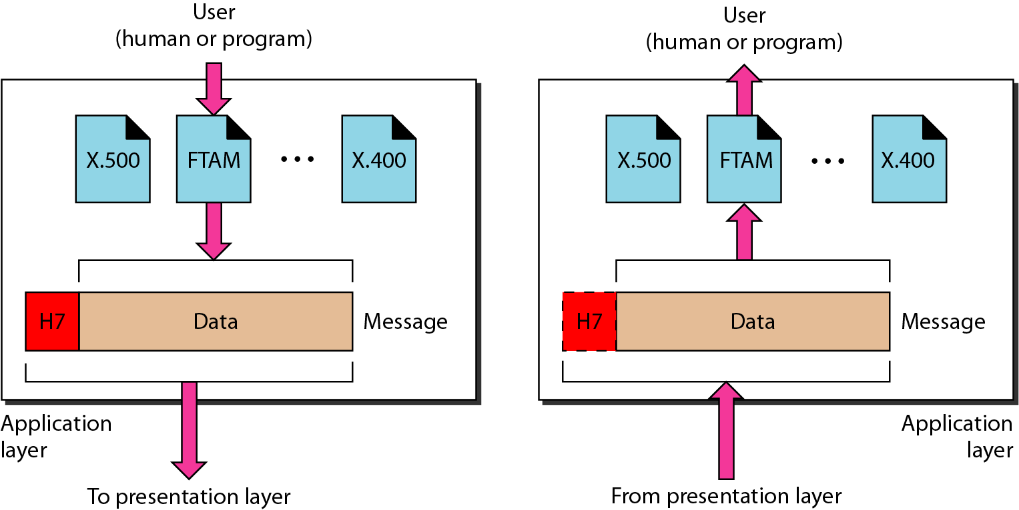
Application layer
1.63

Slide 64
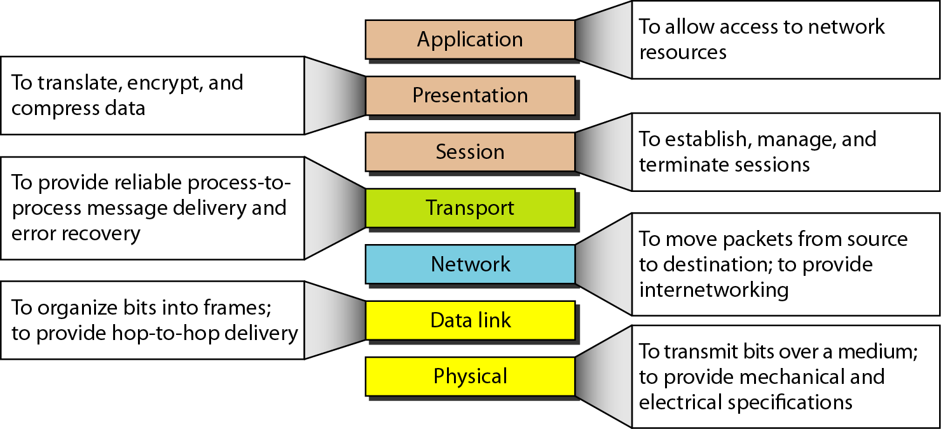
Summary of layers
1.64

Slide 65
Summary of layers
OSI Model
 | Data unit | Layer | Function
User support layers | Data | 7. Application | Network process to application
 |  | 6. Presentation | Data representation and encryption
 |  | 5. Session | Inter-host communication
User⬄ Network | Segment | 4. Transport | End-to-end connections and reliability
Network support layers | Packet | 3. Network | Path determination and logical addressing
 | Frame | 2. Data Link | Physical addressing
 | Bit | 1. Physical | Media, signal and binary transmission
Sender
Receiver
1.65

Slide 66
2.TCP/IP Model
1.66

Slide 67
1-5.2 TCP/IP PROTOCOL SUITE
The layers in the TCP/IP protocol suite do not exactly match those in the OSI model. The original TCP/IP protocol suite was defined as having four layers: host-to-network, internet, transport, and application. However, when TCP/IP is compared to OSI, we can say that the TCP/IP protocol suite is made of five layers: physical, data link, network, transport, and application.
Topics discussed in this section:
Physical and Data Link Layers Network Layer Transport Layer
Application Layer
1.67

Slide 68
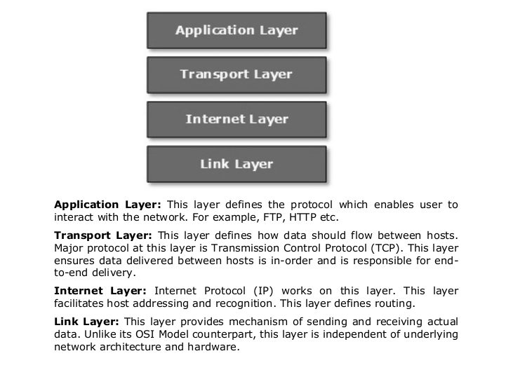
TCP/IP Model

Slide 69
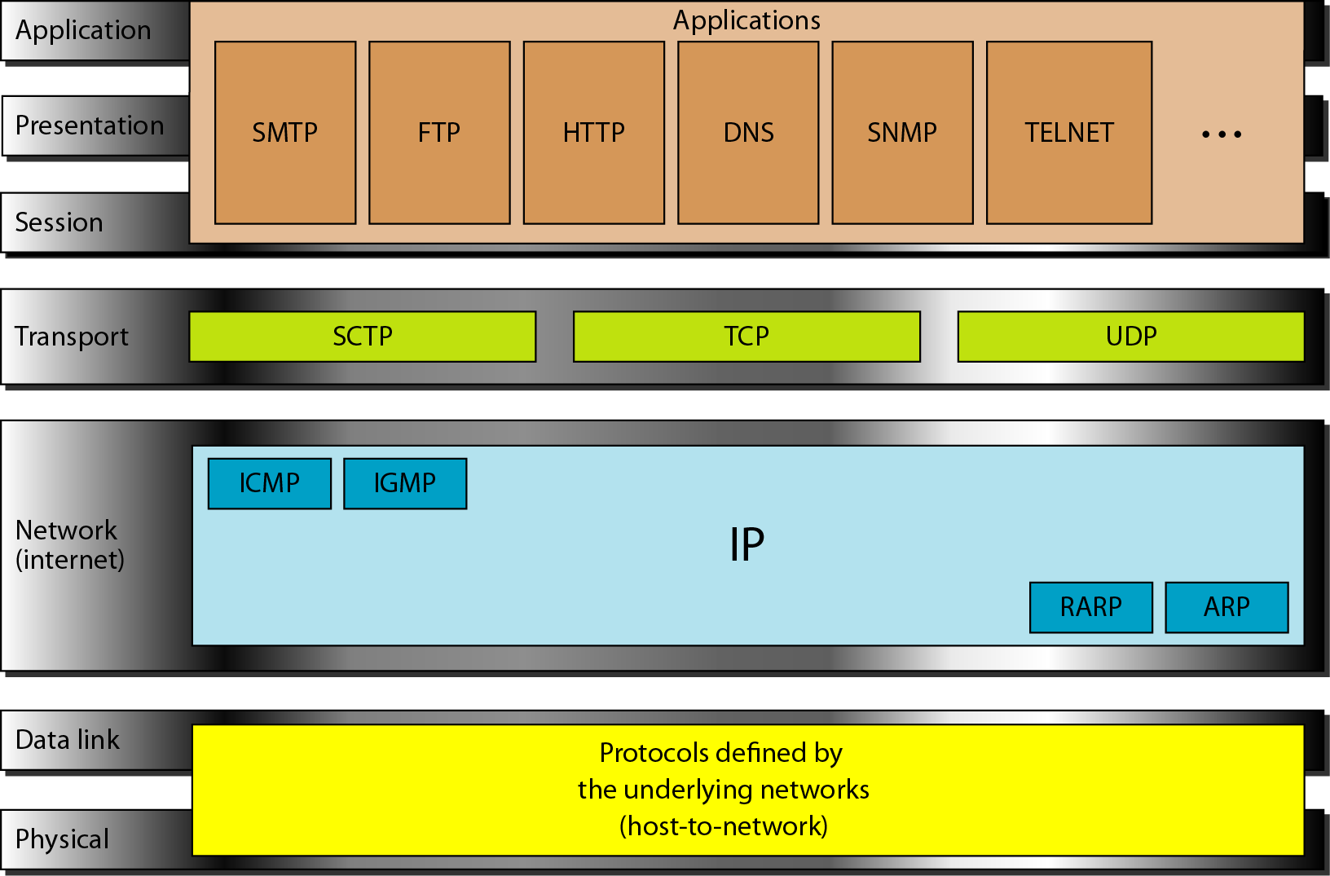
TCP/IP and OSI model
OSI Model
TCP/IP Model
1.69

Slide 70
Internet Layer
TCP/IP support the Internet Protocol IP ( unreliable).
IP is a host-to-host protocol.
Supporting protocols:
Address Resolution Protocol (ARP)
Reverse Address Resolution Protocol (RARP)
Internet Control Message Protocol (ICMP)
Internet Group Message Protocol (IGMP)
1.70

Slide 71
Transport Layer
Process-to-process protocol.
User Datagram Protocol (UDP)
Transmission Control Protocol (TCP)
Stream Control Transmission Protocol (SCTP)
1.71

Slide 72
Types of Transmission Medium

Slide 73
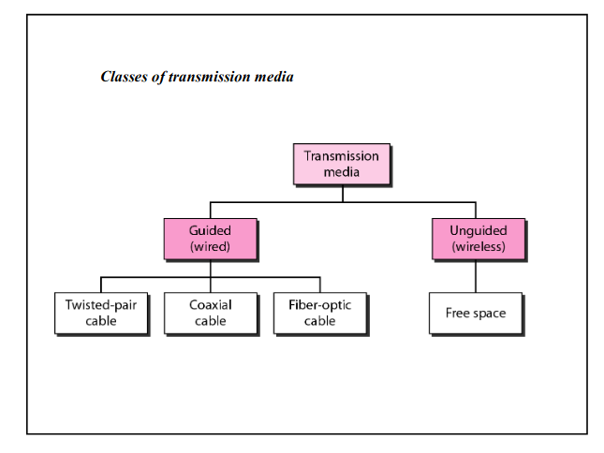
A transmission medium can be broadly defined as anything that can carry information from a source to a destination.

Slide 74
GUIDED MEDIA:
Guided media, which are those that provide a conduit from one device to another, include twisted-pair cable, coaxial cable, and fiber-optic cable. A signal traveling along any of these media is directed and contained by the physical limits of the medium.
Twisted-pair and coaxial cable use metallic (copper) conductors that accept and transport signals in the form of electric current.
Optical fiber is a cable that accepts and transports signals in the form of light.

Slide 75
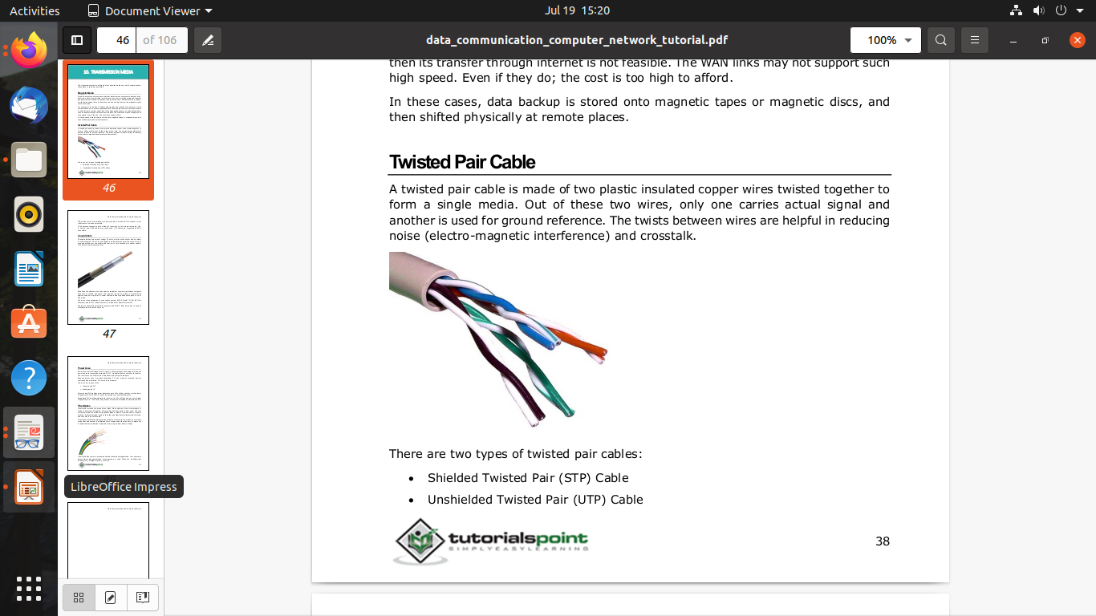
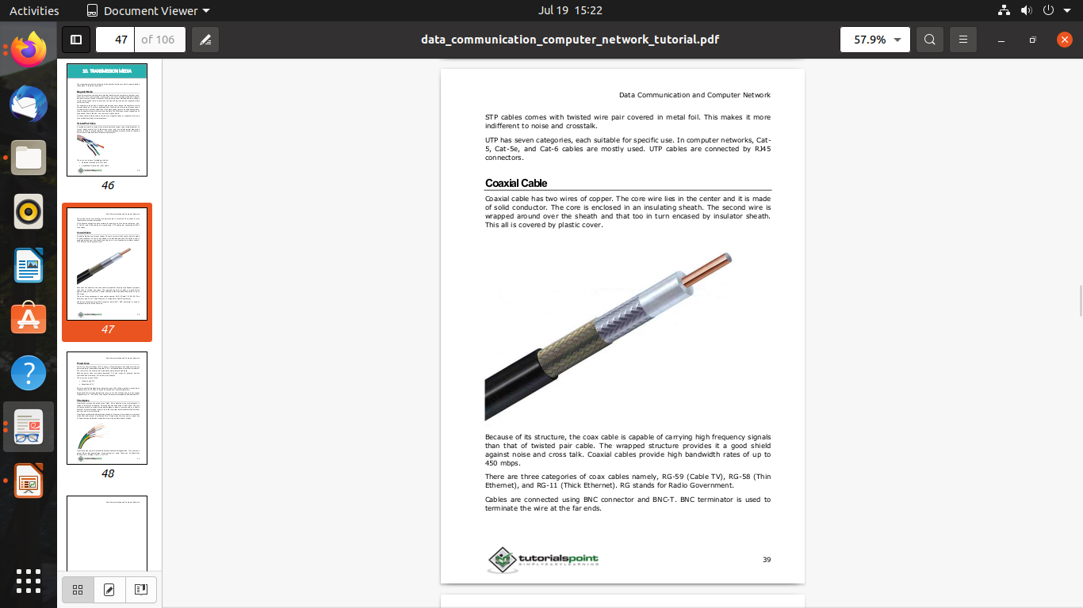
1.Twisted Pair Cable:

Slide 76
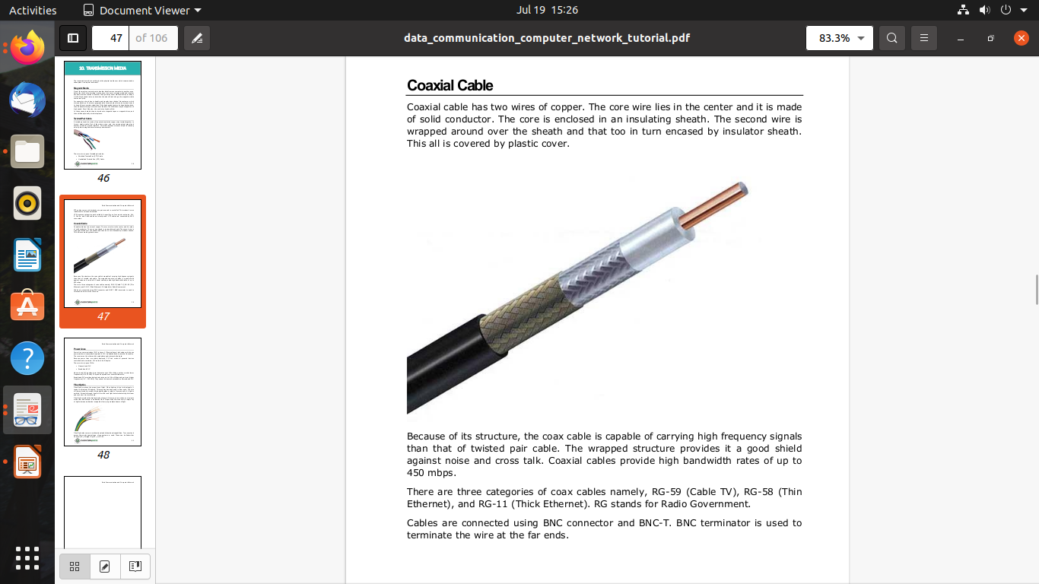
2. Coaxial Cable

Slide 78
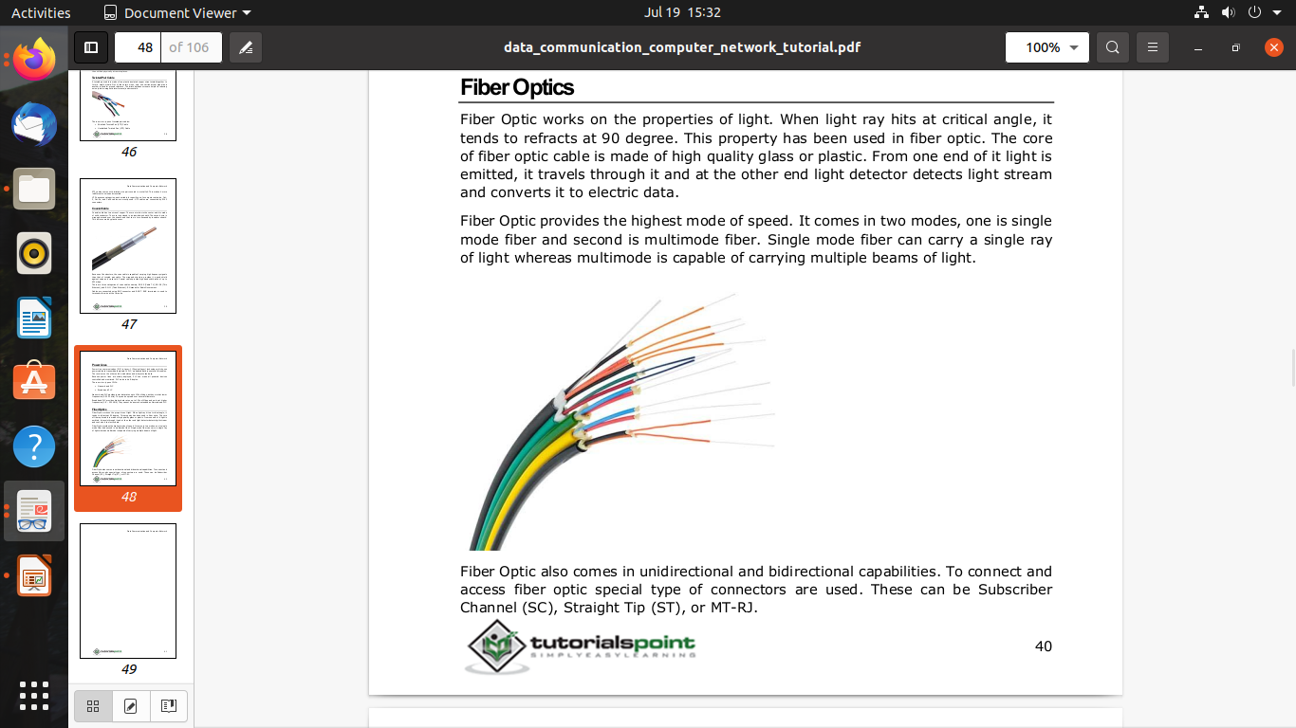
3. Fiber Optic Cables: A fiber-optic cable is made of glass or plastic and transmits signals in the form of light.

Slide 79
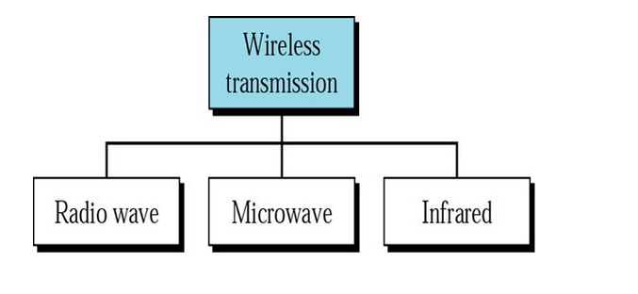
UNGUIDED MEDIA: WIRELESS

Slide 80
1. Radio Waves:
Radio waves, for the most part, are omnidirectional. When an antenna transmits radio waves, they are propagated in all directions. This means that the sending and receiving antennas do not have to be aligned.
Radio waves, particularly those waves that propagate in the sky mode, can travel long distances.
Waves ranging in frequencies between 3 kHz and 1 GHz are normally called radio waves

Slide 81
2.Microwaves:
Electromagnetic waves having frequencies between 1 and 300 GHz are called micro-waves.
Microwaves are unidirectional. When an antenna transmits microwave waves, they can be narrowly focused. This means that the sending and receiving antennas need to be aligned.

Slide 82
3. Infrared:
Infrared waves, with frequencies from 300 GHz to 400 THz (wavelengths from 1 mm to 770 nm), can be used for short-range communication.
Infrared waves, having high frequencies, cannot penetrate walls.

Slide 83
1-6 ADDRESSING
Four levels of addresses are used in an internet employing the TCP/IP protocols: physical, logical, port, and specific.
Topics discussed in this section:
Physical Addresses Logical Addresses Port Addresses Specific Addresses
1.83

Slide 84
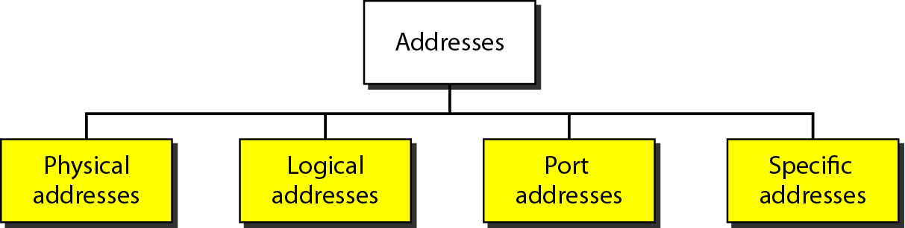
Addresses in TCP/IP
1.84

Slide 85
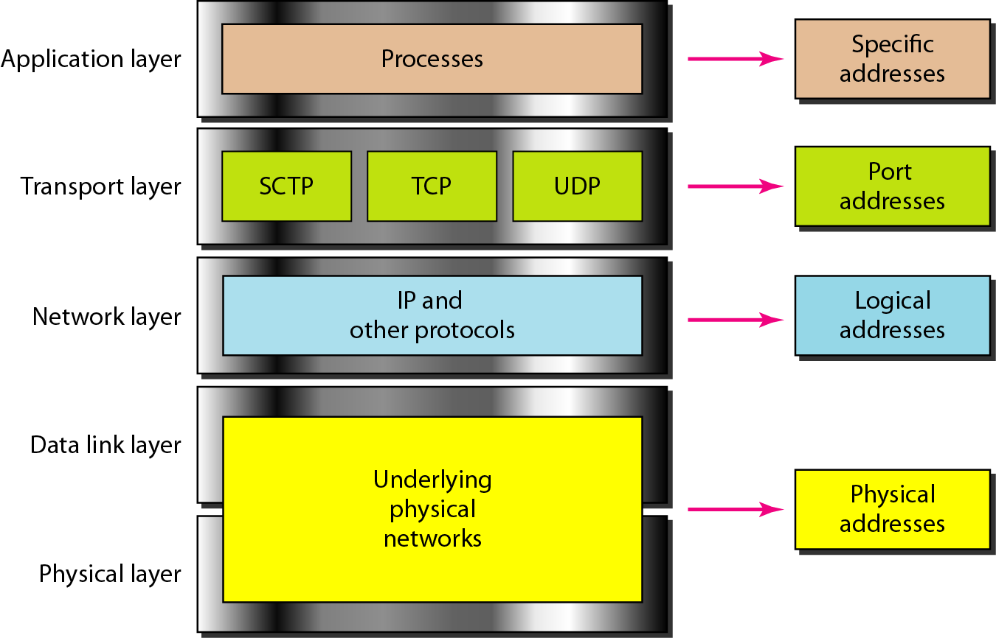
Relationship of layers and addresses in TCP/IP
1.85

Slide 86
Physical Address
Physical addresses are imprinted on the NIC. Most local-area networks (Ethernet) use a 48-bit (6-byte) physical address written as 12 hexadecimal digits; every byte (2 hexadecimal digits) is separated by a colon.
Example:
07:01:02:01:2C:4B A 6-byte (12 hexadecimal digits) physical address.
1.86

Slide 87
Physical Address
known also as the MAC address
Is the address of a node as defined by its LAN or WAN
It is included in the frame used by data link layer
The physical addresses in the datagram may change from hop to hop.
1.87

Slide 88
Logical Address
IP addresses are necessary for universal communications that are independent of physical network.
No two host address on the internet can have the same IP address
IP addresses in the Internet are 32-bit address that uniquely define a host.
The physical addresses will change from hop to hop,
but the logical addresses usually remain the same.
1.88

Slide 89
Port addresses
Port address is a 16-bit address represented by one decimal number ranged from (0-65535) to choose a process among multiple processes on the destination host.
Destination port number is needed for delivery.
Source port number is needed for receiving a reply as an acknowledgments.
In TCP/IP , a 16-bit port address represented as one single number. Example: 753
The physical addresses change from hop to hop,
but the logical and port addresses usually remain the same.
1.89

Slide 90
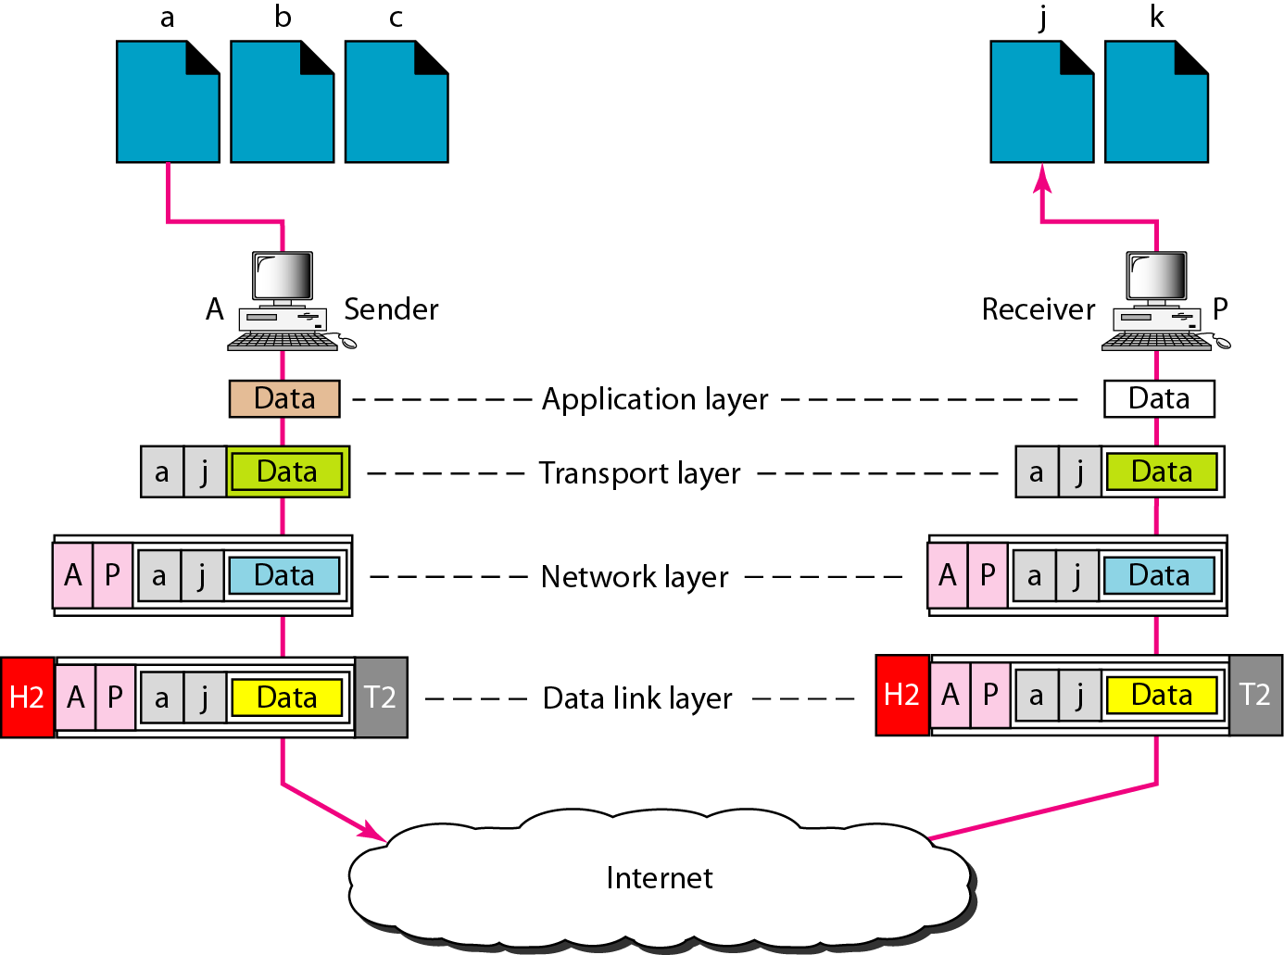
Port addresses
1.90

Slide 91
Specific addresses
E-mail address (user1@ksu.edu.sa)
Universal Resource Locator (URL) (www.ksu.edu.sa)
The Domain Name System (DNS) translates human-friendly computer hostnames ( URL) into IP addresses. For example, www.example.com is translated to 208.77.188.166
1.91

Slide 92
Network Architectures:
1.Client-Server
2.Peer To Peer
3.Hybrid

Slide 93
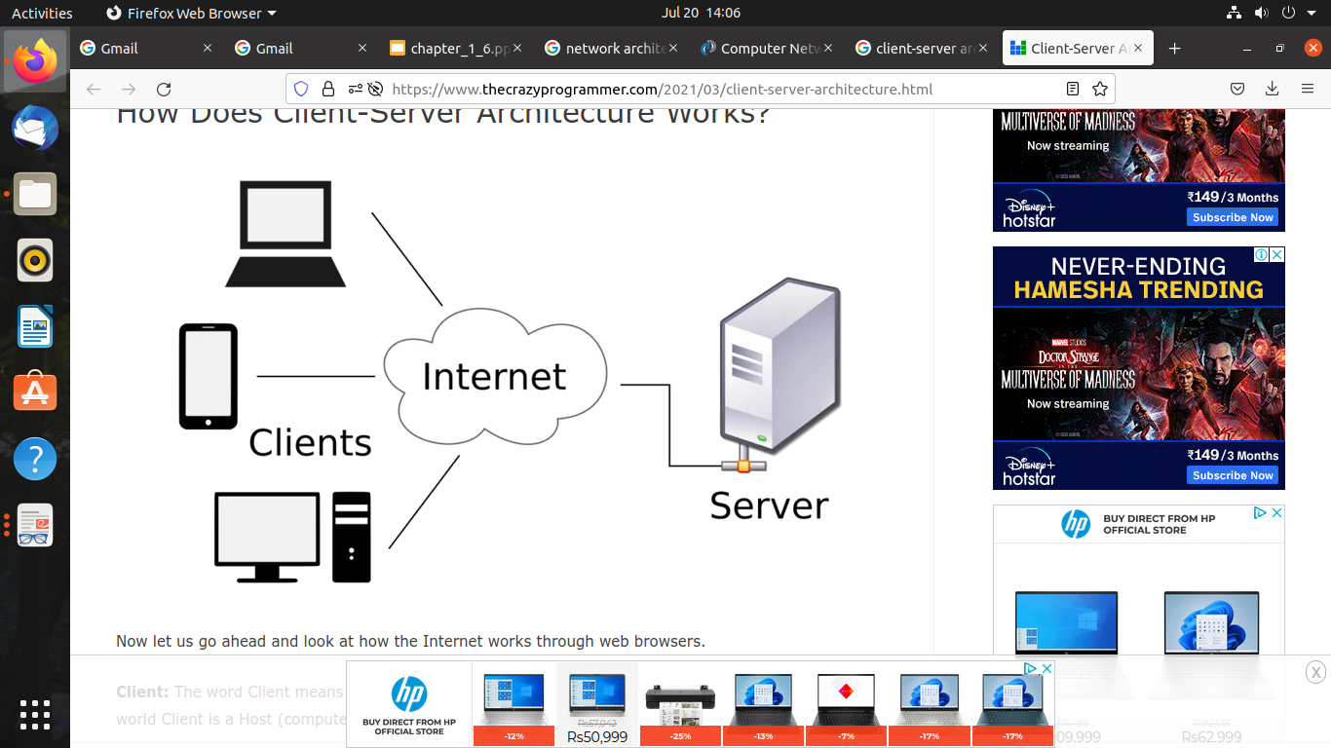
1.Client-Server
One remote process acts as a Client and requests some resource from another application process acting as Server.
The server-client mainly relies on sending the
request to another program to access the service
made accessible by the server.
A client-server relationship corresponds to
the request–response pattern.
A system can act as Server and Client
simultaneously. That is, one process is acting as Server and another is acting as a client. This may also happen that both client and server processes reside on the same machine.

Slide 94
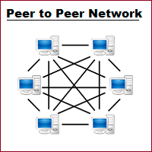
2.Peer To Peer
Peer-to-peer architecture (P2P architecture) is a
commonly used computer networking architecture
in which each workstation, or node, has the same
capabilities and responsibilities.
Due to the absence of a central device in
charge of tasks, this architecture is also known as decentralized architecture.
Each computer has special rights for resource sharing, however this might cause issues if the computer with the resource is unavailable.
Useful in smaller environments with less number of computers.

Slide 95
3.Hybrid
Hybrid networks are the networks that are based on both peer-to-peer & client-server relationship.
Hybrid networks incorporate the best features of workgroups in peer-to-peer networks with the performance, security and reliability of server-based networks.
Hybrid networks still provide all of the centralized services of servers, but they also allow users to share and manage their own resources within the workgroup.

Slide 96
Network Devices
Hardware devices that are used to connect computers, printers, fax machines and other electronic devices to a network are called network devices.
Bridge
Switch
Router
Gateway
Access Point

Slide 97
Bridge:
Bridges are connection devices between networks that operate in the data link layer of the OSI model.
Bridges are used to segment networks that have grown to a point where data traffic through the physical environment of the network slows down the global transfer of information.
Like repeaters, bridges are used to connect similar LANs together, for example, Ethernet-to-Ethernet and operate at the bottom two layers of the OSI model, i.e. physical layer and data link layer.
Bridgescan examine MAC addresses
By knowing which MAC addresses reside in each of the segments of the network, the bridge can prevent data traffic from a specific segment from passing to another segment of the network that also connected to the bridge.

Slide 98
Switch:
Switch is a network device that connects other devices to Ethernet networks through twisted pair cables. It uses packet switching technique to receive, store and forward data packets on the network. The switch maintains a list of network addresses of all the devices connected to it.
On receiving a packet, it checks the destination address and transmits the packet to the correct port.
Before forwarding, the packets are checked for collision and other network errors.
A network switch is a device that operates at the Data Link layer of the OSI model
Router:
A router is a network layer hardware device that transmits data from one LAN to another if both networks support the same set of protocols.
So a router is typically connected to at least two LANs and the internet service provider (ISP).
It receives its data in the form of packets, which are data frames with their destination address added. Router also strengthens the signals before transmitting them. That is why it is also called repeater.

Slide 99
Gateway:
The gateway operates at the network layer (Layer 3) of the OSI Model. The gateway is used when transmitting packets. When packets are sent over a network, the destination IP address is examined.
Gateway is a network device used to connect two or more dissimilar networks.
Gateway uses packet switching technique to transmit data from one network to another.
It is similar to a router, the only difference being router can transmit data only over networks that use same protocols.
Access Point:
An Access Point is a Layer 2 device and therefore works on Layers 1 and 2.
While an access point (AP) can technically involve either a wired or wireless connection, it commonly means a wireless device.
Wireless access points (WAPs) consist of a transmitter and receiver (transceiver) device used to create a wireless LAN (WLAN). Access points typically are separate network devices with a built-in antenna, transmitter and adapter.

Slide 100
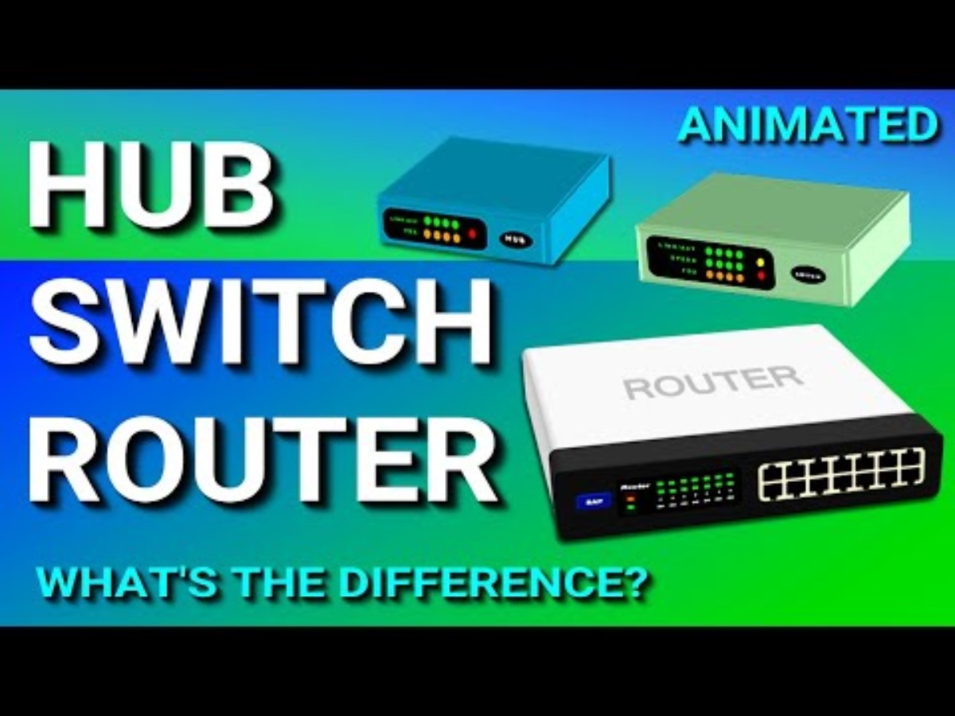

Slide 101
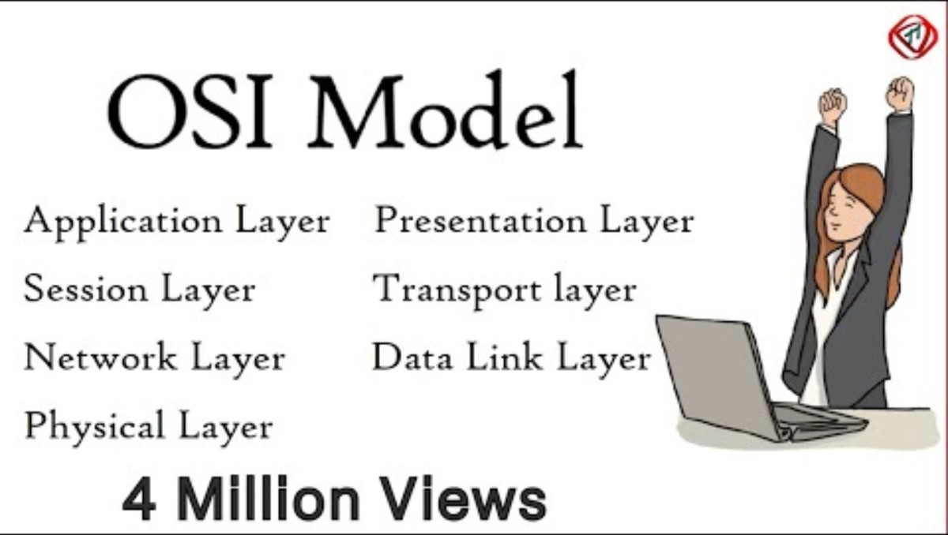

Slide 102
Line Coding Schemes:
Line coding refers to the process of converting digital data into digital signals.
Whenever we transmit data it is in the form of digital signals, so with the help of line coding, we can convert a sequence to bits (or encoding) into a digital signal which then again converted into bits by the receiver (or can be said as decoded by the receiver).
For all this to happen we need line coding schemes which could also be able to avoid overlapping and distortion of signals.
There are various line coding techniques to convert data elements to signal elements.
These include Unipolar (NRZ), Polar (NRZ, RZ, Biphase), Bipolar (AMI, Pseudoternary) , Multilevel (2B1Q, 8B6T, 4D-PAM5) and Multitransition (MLT-3). Biphase line coding include Manchester and Differential Manchester encoding.

Slide 103
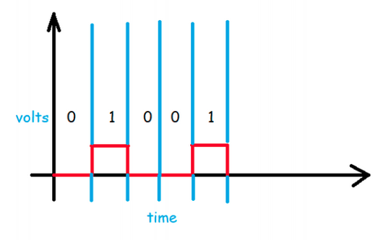
Unipolar
In Unipolar we are simply representing a signal in a graphical form where positive voltage represents logical or binary 1 and zero voltage represents logical zero.
We can say that it's the simplest line code.
The drawback of this scheme is that it is not self-clocking which means that it can't be decoded without a separate clock signal or any other synchronization source.
The term Non-Return to Zero (NRZ) means that the signal (the red line in the above diagram) will not return to zero in middle of the bit (i.e. either 0 or 1). Unipolar schemes were generally designed as NRZ schemes.

Slide 104

Polar
As its name suggests polar which means it will have both positive and negative values for voltages or amplitude.
Polar line Encoding includes NRZ, RZ, Biphase and Biphase line coding include Manchester and Differential Manchester.
NRZ scheme, we have NRZ-L (i.e. NRZ-Level) and NRZ-I (i.e. NRZInvert).
In the above diagram, we can simply notice that high volt is for logical 0 and low volt is for logical 1. This is the representation of NRZ-Level.

Slide 105

5. Now in this one, the idea is that whenever we encounter logical 1 then the signal will be inverted, but when it encounters logical 0 then it remains on the same side. This is the NRZ-Invert.
6. Return to Zero (RZ):Return to zero proved out to be a nice alternative or say a solution to NRZ drawbacks. Unlike NRZ, RZ uses three values of voltage i.e. positive, negative, zero. And as the name suggests it returns to zero in the middle of each bit.
7. The idea behind the above representation is that logical 1 is represented as half-positive and half-zero volts and the logical 0 is represented as halfnegative and half-zero volts.

Slide 106

8. Biphase: Biphase line coding include Manchester and Differential Manchester encoding.
9. Manchester encoding is a widely used line coding scheme that embeds timing information in the transmitted signal
10. There is a transition (high-to-low or low-to-high) in the middle of every bit time, making it easy for the receiver to retrieve a clock signal from the incoming bit stream and maintain synchronization with the transmitted signal.
11.A logic high (binary one) is represented by a positive pulse with a period of half a bit time followed by a negative pulse of the same duration. Similarly, A logic low (binary zero) consists of a negative pulse followed by a positive pulse, each with a period of half a bit time.

Slide 107

12.Manchester encoding suffers from the problem that, if the signal gets inverted (i.e. changes polarity) whilst in transit, it is transformed from one convention to the other, leading to polar ambiguity (the receiver will interpret ones as zeros, and vice versa).
13. The problem can be overcome by using a variant of Manchester encoding called differential Manchester encoding. Whereas Manchester encoding could be described as combining aspects of polar RZ and NRZ-L, differential Manchester is more like a combination of RZ and NRZ-I.
14.Bit 0 is mapped to signal level transition at the beginning of the bit
interval.Bit 1 is mapped to absence of signal level transition at the beginning of the bit interval

Slide 108


Slide 109


Slide 110
Spread spectrum
Spread spectrum is a form of wireless communications in which the frequency of the transmitted signal is deliberately varied.
There are two types of spread spectrum techniques:
Frequency Hopping Spread Spectrum (FHSS)
Direct Sequence Spread Spectrum (DSSS).
FHSS and DSSS both have their advantages and choosing between one or the other will depend on the type of application for which the technique will be used.

Slide 111
Frequency Hopping Spread Spectrum (FHSS)
The spread spectrum technique in which the carrier frequency is changed according to the pseudo-random noise or sequence injected is called the frequency hopping spread spectrum (FHSS) technique.
The pseudo-random sequence is only available with the transmitter and receiver.
The signal transmitted is injected with noise, increasing the bandwidth of the original information.
At the receiving end, the pseudo-random sequence is removed to retrieve the original information.
The FHSS technique prevents the loss of data and limits noise

Slide 112
2. Direct Sequence Spread Spectrum (DSSS).
In the direct sequence spread spectrum (DSSS) technique, the signal being transmitted is divided and injected with multiple frequencies within a particular frequency band.
The original data is mixed with redundant data bits or code, called chips or chipping code, and the ratio of the chips to information is called the spreading ratio.
A high spreading ratio indicates a wider bandwidth.
DSSS technique helps recover the original data even when a part of the transmitted data is corrupted.

Slide 113

Differences Between FHSS vs. DSSS

Slide 114

Differences Between FHSS vs. DSSS

